Slide 1
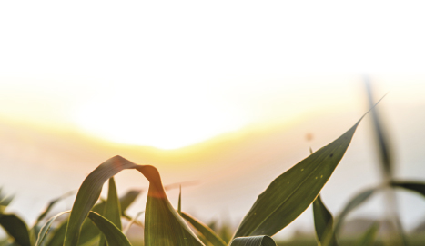





Sustainable Adaptation
of EU Farming Systems
to Climate Change
Monday, 15th October 2018

Slide 2
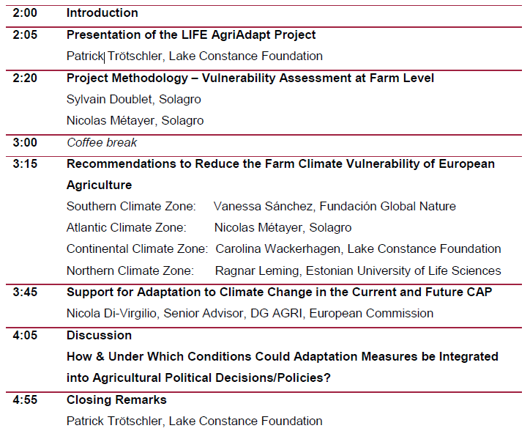
Agenda

Slide 3
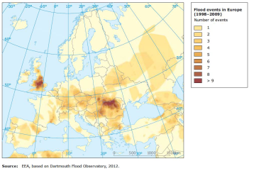
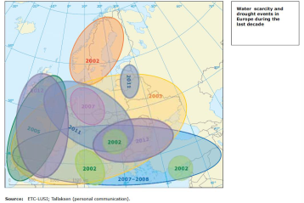
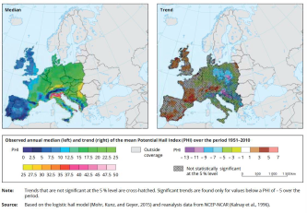
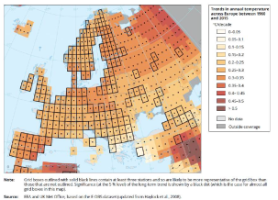
LIFE AgriAdapt
Observed Climate Change

Slide 4
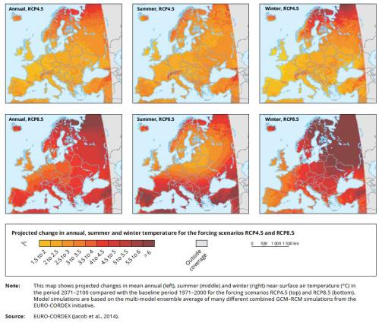
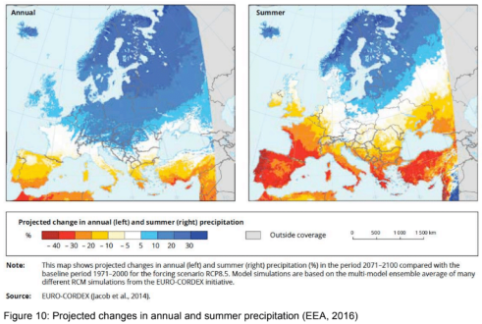
LIFE AgriAdapt
Projected Climate Change

Slide 5
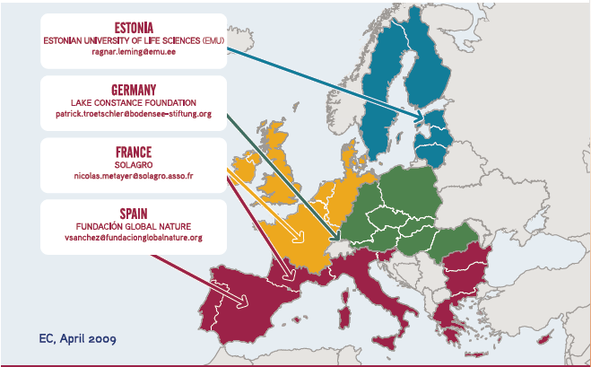
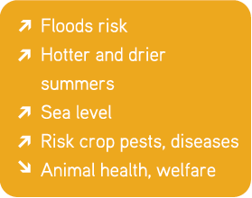
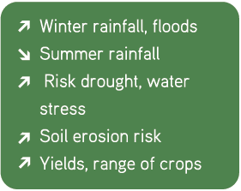
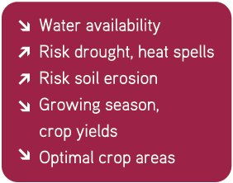
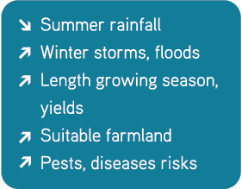
Climate Change – Consequences on European Agriculture

Slide 6
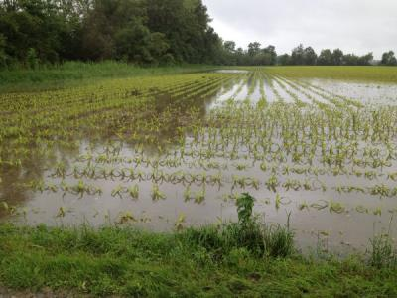
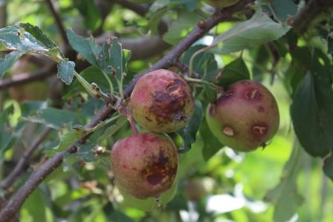
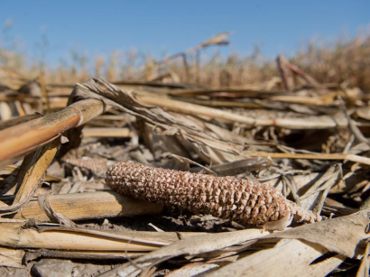
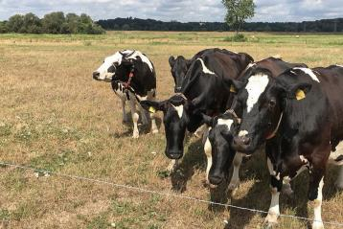
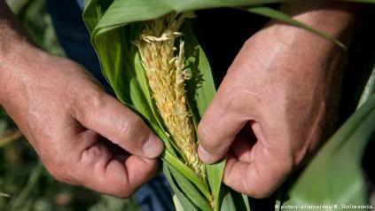
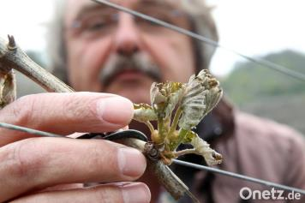
Climate Change – Consequences for farmers?

Slide 7
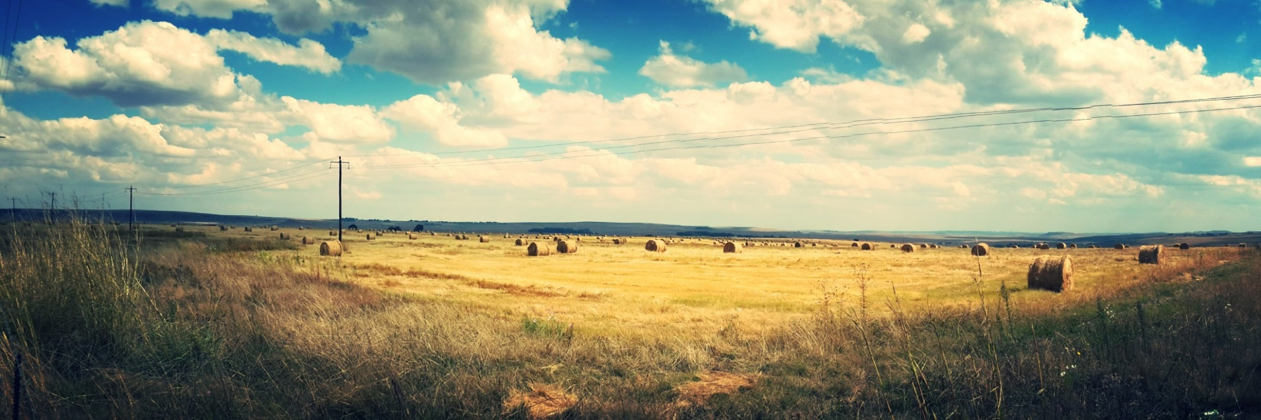
LIFE AgriAdapt
OVERALL OBJECTIVE
  Demonstrate that 3 main farming systems (livestock, arable and permanent crops) can be more climate resilient by implementing sustainable adaptation measures.

Slide 8
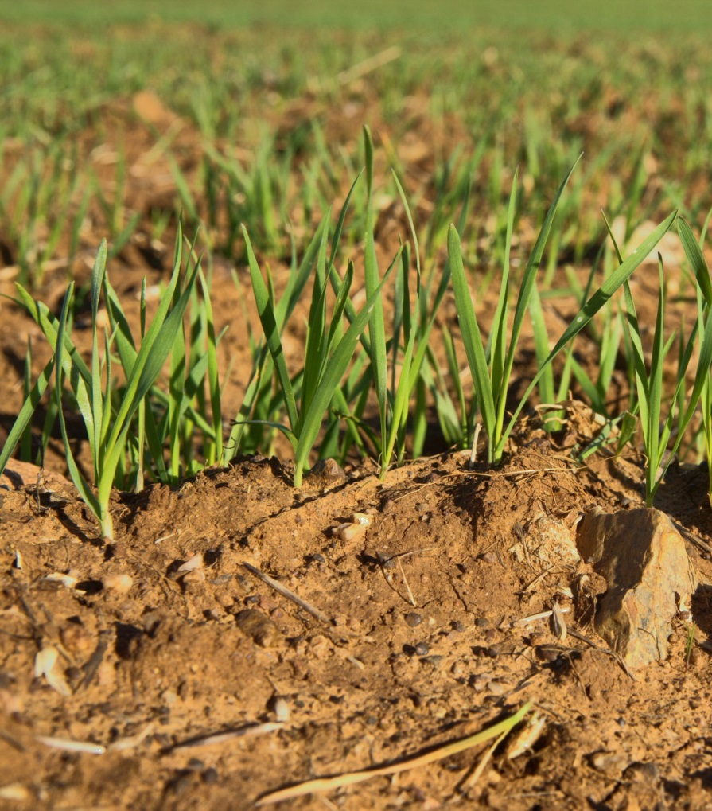
LIFE AgriAdapt
SPECIFIC OBJECTIVES
      to improve the knowledge base for the development, assessment and monitoring of the climate change vulnerability at farm-level
      to test sustainable measures and management approaches on 120 pilot farms.
      to promote sustainable adaptation measures by demonstrating and disseminating actions
      to raise awareness and know-how of current farmers and future farmers for sustainable adaptation options
      to contribute to the development and implementation of EU, national and regional policies on climate change adaptation
Notes:
to improve the knowledge base for the development, assessment and monitoring of the climate change vulnerability at farm-level by developing and testing a common method for the four EU Climate Risk Regions
to test sustainable measures and management approaches for climate change adaptation by identifying and implementing them on 120 pilot farms.
to promote sustainable adaptation measures and to enhance the capacity to apply that knowledge in practice by demonstrating and disseminating actions for farmers, farmers associations, technical consultants, food standard organisations and agricultural assurance companies.
to raise awareness and know-how of current farmers and future farmers for sustainable adaptation options at farm level by developing, creating and disseminating training packages for agriculture trainers, schools and capacity building centres and stakeholders.
to contribute to the development and implementation of EU, national and regional policies on climate change adaptation by transferring best-practise and know-how to political, agricultural and food business stakeholders and by mainstreaming across policy areas.

Slide 9
Climate Change – Consequences on European Agriculture
      4 project partners
      in 4 EU Climate risk areas
      40 months
      09/2016 – 12/ 2019
      overall Budget
      2.150.000 Euro

Slide 10
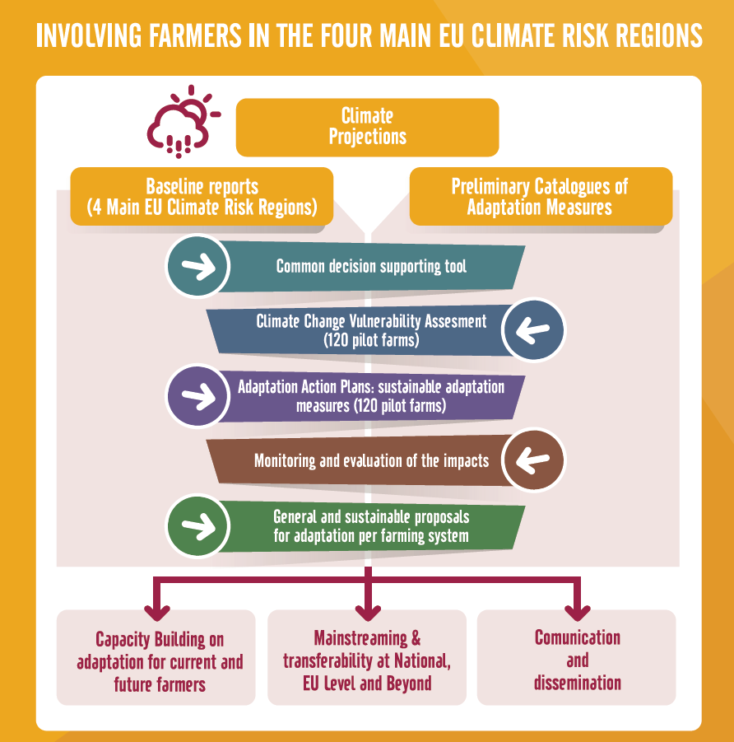
LIFE AgriAdapt
IN PRACTICE
      4 Baseline reports with agro climate grids per climate zone
      Compilation of sustainable adaptation measures
      One decision supporting tool for THE FARM vulnerability assessment
      120 Pilot farms with dominant and minor farming practices.

Slide 11






LIFE AgriAdapt
PROJECT FUNDING
France: ADEME, Ministère de l’Agriculture et de l’Alimentation, Ministère de la Transition Ecologique et Solidaire, Agence de l’Eau Seine Normandie, Agence de l’Eau Adour Garonne, Météo France
GERMANY: Ministerium Ländlicher Raum und Verbraucherschutz Baden-Württemberg, Landratsamt Bodenseekreis, OMIRA, Rentenbank
Spain: Fundación Biodiversidad del Ministerio de Agricultura y Pesca, Alimentación y Medio Ambiente

Slide 12
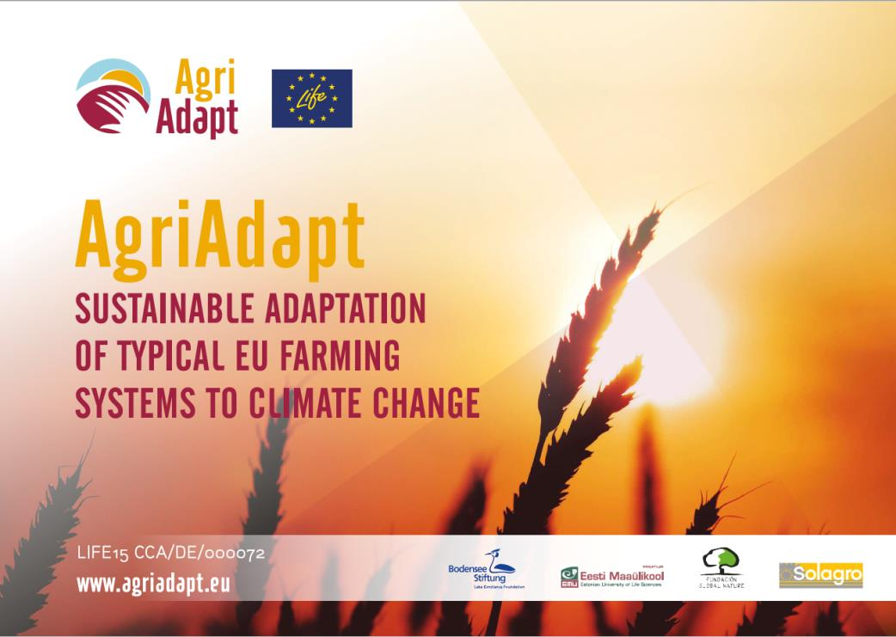
Thanks for your attention

