Slide 1






Sustainable Adaptation of EU Farming
Systems to Climate Change
Brussels
Monday, 15th October 2018

Slide 2
Project Methodology

Slide 3
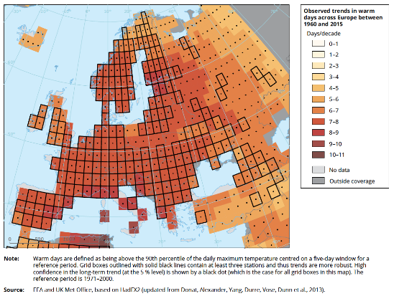
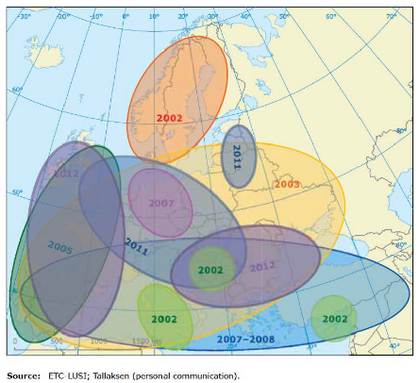
CLIMATE CHANGE OBSERVATIONS
Water scarcity and drought events in Europe during the last decade.

Slide 4
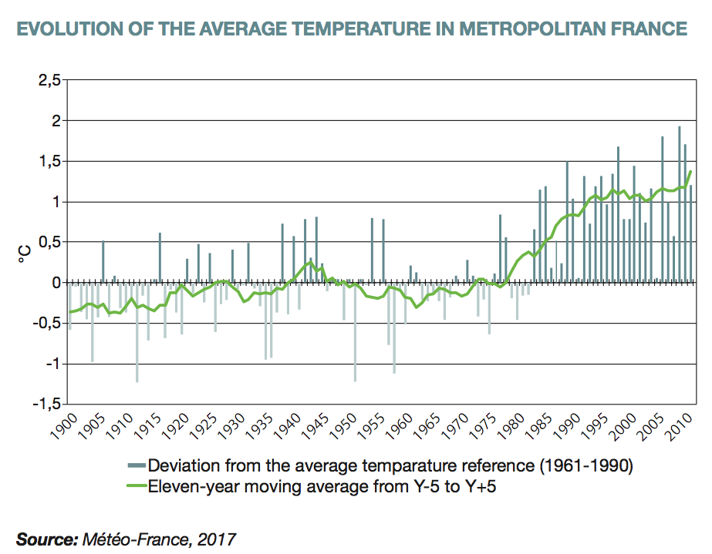
CLIMATE CHANGE OBSERVATIONS
The increase in global average temperatures is very clear, the warming becomes more severe since 1980.
Evolution of the average temperature in metropolitan France
Annual average air temperatures in Tartu-Tõravere weather station, South-East Estonia (Luhamaa et al. 2015).

Slide 5
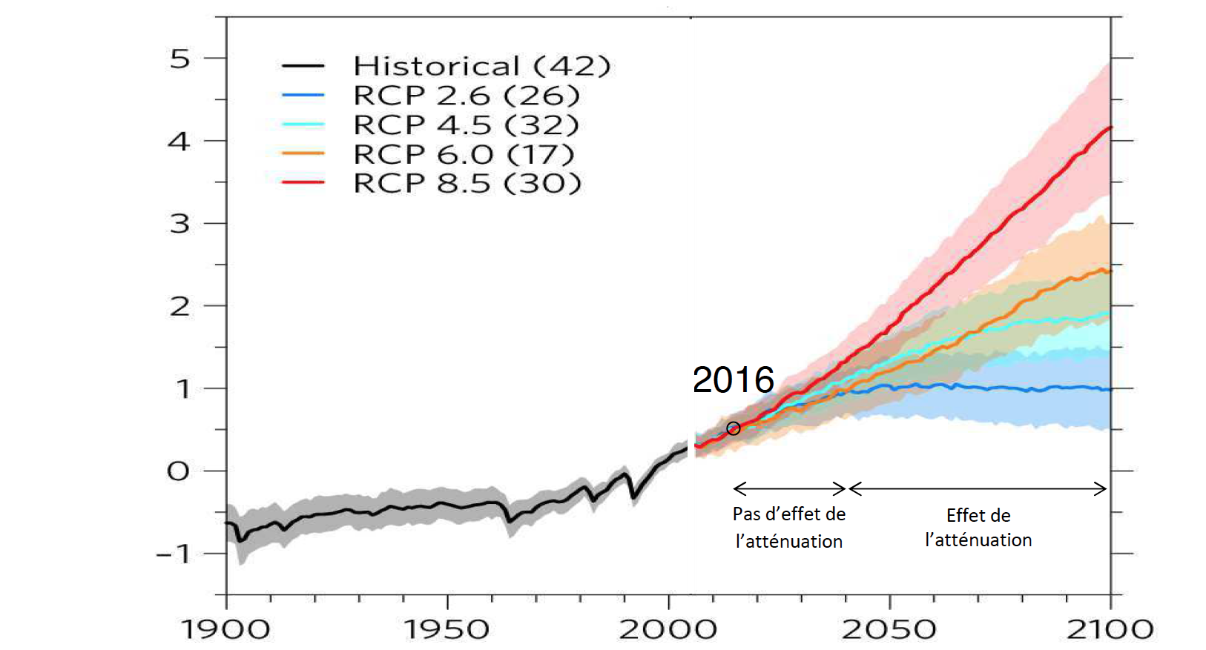
ADAPTATION & CLIMATE POLICIES
For the near future (time horizon 2040), few differences exist within the different RCPs scenarios which makes adaptation a necessity for farmers.
Representative Concentration Pathway scenarios
RCPs from IPPC AR5.
No mitigation effect
Mitigation effect
Notes:
farmers have since already adapted their practices, but the challenge for the next decades is that changes take place in a very short time period.

Slide 6
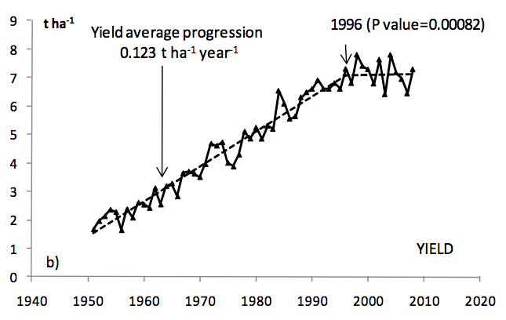
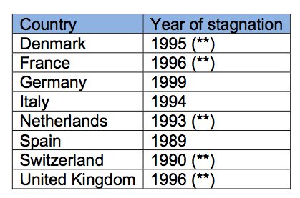
CLIMATE AS A PROXY FOR CROP YIELD IN EUROPE
The last two decades are witnessing a decline in the growth trend of cereal yields in many European countries, climate change (heat stress, drought) being one of the explaining factors (Brisson et al, 2010).
trend for bread wheat yield in France with a stagnation inflexion in 1996
Same trend for European countries

Slide 7
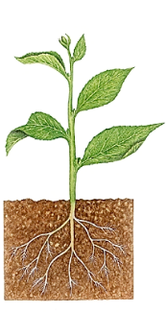
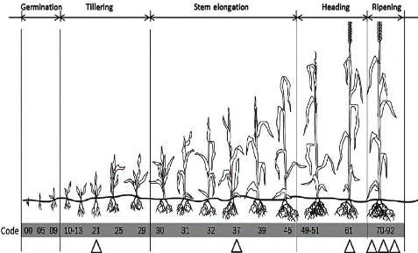
KEY CLIMATIC PARAMETERS FOR CROPS
From a physiological point of view, a crop needs for its development and growth: radiation, CO₂, an accumulation of high temperatures, an accumulation of low temperatures (for some of them) and water.
4 major weather events
Degree days: engine of plant development
High temperatures
Low temperatures
Water deficit
Excess water
Notes:
High temperature requirements
The temperature is the engine of development of plants. Development is governed primarily by temperature (concept of Growing Degree Days – GDD*). The temperature will play on the speed of development of culture and therefore cycle times (including grain filling and therefore yield). Each plant (and each variety) has its own thermal requirements: a corn 1 700 GDD will need to reach a point of harvest (Tbase 6 ° C.) winter wheat will need GDD 2 350 (Tbase 0 ° C.) to reach ripening.
Rising temperatures can therefore reduce the accumulation of cold temperatures and have negative impacts on flowering crops and / or buds of woody species.
Water requirements
Water is the plant growth factor. Growth is not regulated by many factors such as water sufficiency (or water stress), stomatal regulation or evapotranspiration.
A lack of water have a negative impact on the production of biomass. Excess water (during a long period) can lead to root suffocation phenomenon.

Slide 8
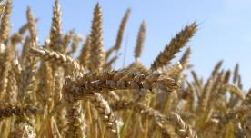
YIELD COMPILATION
Soft wheat - Marne (France)
Yields
2000 - 2017
Solagro from Agri4Cast

Slide 9
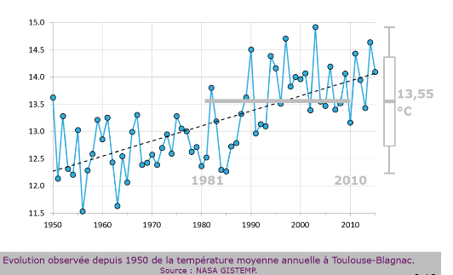
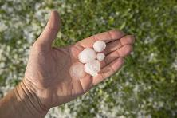
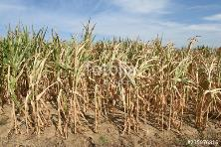
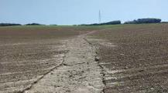
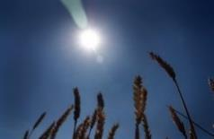
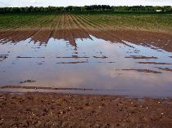
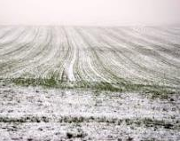
FROM VULNERABILITY TO ADAPTATION:
A LEARNING PROCESS FOR FARMERS
… and climate trajectories
Climatic hazards...
Hail
Drought
Erosion
Heat wave
Intense frost
Flooding
Agriadapt roadmap for adaptation
2019
Vulnerability unknown
Awareness of Vulnerability, but no solutions identified
Awareness of Vulnerability, solutions identified but no idea of their efficiency
Awareness of Vulnerability, solutions identified and their efficiency (advantages and disadvantages) is quantified
2017

Slide 10
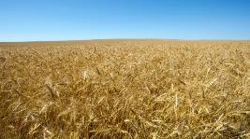
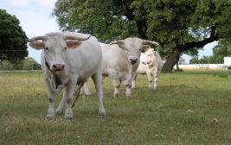
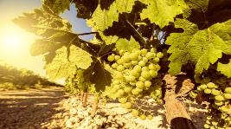
COMMON DECISION FARM TOOL: OBJECTIVES
Suitable for the 4 European agro-climatic zones
Able to assess different farm types:
    Grain production farms
    Livestock farms: dairy cattle, meat cattle, and pigs & poultry
    Perennial productions: apples trees and vineyard
Perform climatic vulnerability assessments at farm level:
    Priorize climate risks at farm level through a scoring method
    Agronomic and Animal vulnerability
    Current climatic context and near future (2020-2050)
Able to reduce climatic vulnerability by suggesting sustainable adaptation options.

Slide 11
AGRIADAPT VULNERABILITY ASSESSMENT
The vulnerability level (or risk level) combine the probability of occurrence of climate stress (exposure) and the extent of the consequences (crop impact).
Exposure
Impact
Exposure Frequency of climate stress
(i.e., key climatic parameters)
Impact or sensitivity
% of crop yield reduction experienced
Vulnerability
Vulnerability = Exposure x Impact

Slide 12
AGRIADAPT VULNERABILITY ASSESSMENT
The assessment help to prioritize the level of vulnerability.
No scientific unit to measure a risk. To assess the levels of Exposure and Sensitivity, qualitative evaluation trough rating scale is then required.
AgriAdapt Vulnerability matrix
Notes:
No use of numerical models of plant growth, pragmatic methodology based on simple parameters.

Slide 13
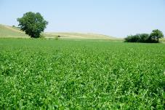
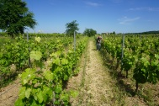
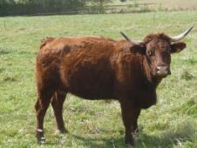
COMMON DECISION TOOL:
A MULTISTEP APPROACH FROM the AGRO CLIMATE ZONE TO FARM SCALE
1. Agro Climate Zone
The analysis provide a framework for analysis at the farm level: identified in a recent past period the strongly impacted years, main climate events,…
2. Farm Scale
Once the farm is characterized, assessment of vulnerability of the farm’s crops and reduction of Near Future Farm vulnerability

Slide 14
Agro Climate Zone Tool:
Climate
Recent Past (30 years) observations
Climate projections near future (about 2030)

Slide 15
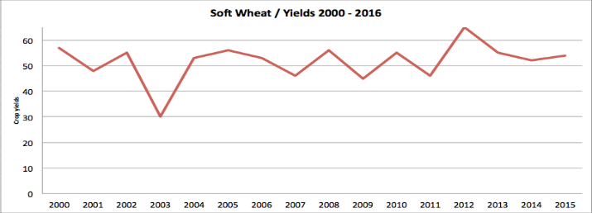


Agro Climate Zone Tool:
Climate
Recent Past (30 years) observations
Climate projections near future (about 2030)
Crop
Crop yield compilation (15 years)
Average yield and variations
Nb day (May+June) >25°C=31
Rainfall (May+June)=60
Rainfall (May+June)=200
Nb days (May+June) >25°C=39
Rainfall (May+June)=59
Nb days (May+June) >25°C=36
Rainfall (May+June)=80

Slide 16
Agro Climate Zone Tool:
Climate
Recent Past (30 years) observations
Climate projections near future (about 2030)
Crop
Crop yield compilation (15 years)
Average yield and variations
IAC
Automatic calculation of 60 Agro Climatic Indicators
For Recent Past & Near Future

Slide 17
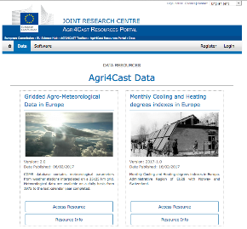
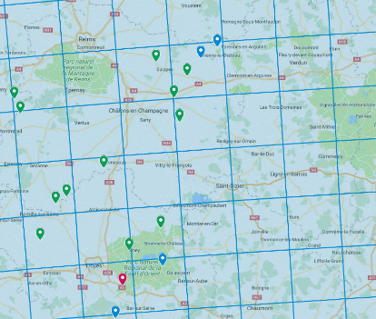
CLIMATE DATA
Automatic calculation of more than 65 ACI
Generic indicators: rainfall, , temperatures, etc.
Fodder indicators: date for grass regrowth, date for 1st grazing , etc.
Cereal crops indicators: end of cycle thermal and hydric stress, etc.
Summer crops indicators: temperatures > 32°C, summer hydric deficit, etc.
Rapeseed crops indicators: drought at sowing, etc.
Vineyards and orchards indicators: date of late frost, Huglin index, etc.
Animal indicators: temperature-humidity index, etc.

Slide 18
Farm Vulnerability Tool:
Farmer Interview
Farm description (last cultural campaign)
Climate events & farm impacts

Slide 19
Farm Vulnerability Tool:
Farmer Interview
Farm description (last cultural campaign)
Climate events & farm impacts
Agronomy vulnerability
Exposure and impact scoring for the main crops / ACZ tool + expertise
Vulnerability scoring is then updated for NF

Slide 20
Farm Vulnerability Tool:
Farmer Interview
Farm description (last cultural campaign)
Climate events & farm impacts
Agronomy vulnerability
Exposure and impact scoring for the main crops / ACZ tool + expertise
Vulnerability scoring is then updated for NF
Animal vulnerability
Vulnerability based on fodder system, feeds resilience & animal welfare during heat weaves
Vulnerability scoring is then updated for NF

Slide 21
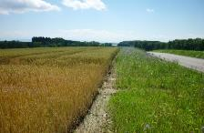
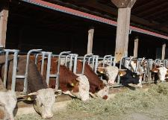
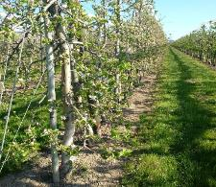
COMMON DECISION TOOL: RELEVANT POINTS
Agriadapt Common Decision Tool
Crop yields:
Regional scale (statistics): annual yield of the last 15 years
Farm scale (average, minimum & maximum)
Climatic data :
Climate daily observations (30 last years) for the Recent Past (RP)
Climate daily projection (30 years) for the Near Future (NF)
Vulnerability scoring:
Qualitative (agronomic expertise & bibliography) and quantitative information
Farm interview:
Agronomic, livestock, economic, climatic data

Slide 22
Vulnerability assessment at farm level
22
Notes:
Tour de table : agri localité, productions

Slide 23
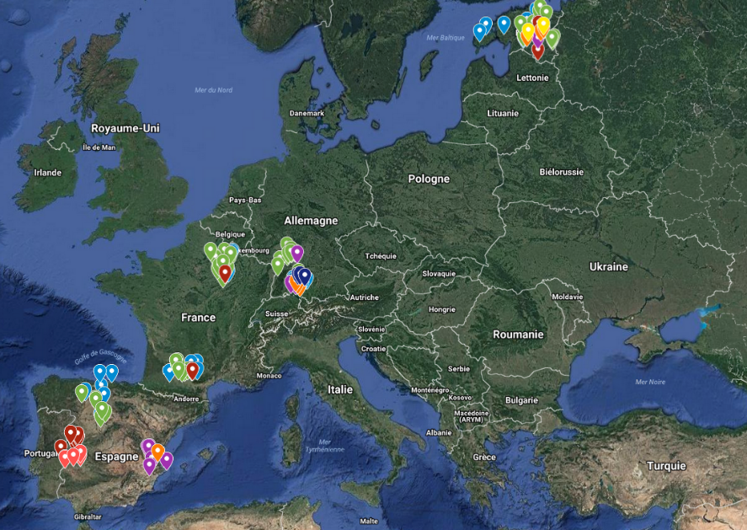
AgriAdapt pilot farms
Notes:
126 pilot farms accross 4 countries
These farms have been selected to ensure variability of size, farming practices.

Slide 24
Pilot farms characteristics
Farming systems, farm size, farming practices
Farm size (ha UAA) | Minimum | Average | Maximum
Spain | 1 | 235 | 1 715
France | 48 | 164 | 380
Germany | 6 | 113 | 322
Estonia | 10 | 725 | 3 770
Notes:
Main productions : cereal crops (45%) & dairy milk (24%)
Farm size: huge diversity of farm size within each of the 4 countries. A few huge farm size in Spain and Estonia.
75% conventionnal, 25 % organic (only 23% in Spain, maxi 36% in Estonia)

Slide 25
Pilot farms characteristics
Soil organic matter content, soil organic matter trend, soil water content

Slide 26
Irrigation
Crops irrigated, % farm UAA irrigated
Notes:
26 farms with irrigation

Slide 27
Irrigation
Total water volume/year, water ratio/ha irrigated, water scarcity risk
Water m³/year | Minimum | Average | Maximum
Spain (n = 11) | 5 600 | 434 342 | 1 294 220
France (n = 11) | 8 400 | 67 614 | 172 000
Germany (n = 4) | 2 400 | 24 200 | 75 600
Notes:
26 farms with irrigation

Slide 28
Cereal crops pilot farms
Farm size (ha UAA) | Minimum | Average | Maximum
Estonia (n = 13) | 65 | 1 026 | 3 770
Germany (n = 12) | 31 | 185 | 527
France (n = 26) | 76 | 160 | 380
Spain (n = 6) | 11 | 146 | 400

Slide 29
Dairy milk pilot farms
Number of dairy cows | Minimum | Average | Maximum
Spain (n = 6) | 87 | 156 | 230
France (n = 7) | 32 | 94 | 240
Germany (n = 8) | 74 | 117 | 250
Estonia (n = 9) | 65 | 448 | 1 819

Slide 30
Dairy milk pilot farms

Slide 31
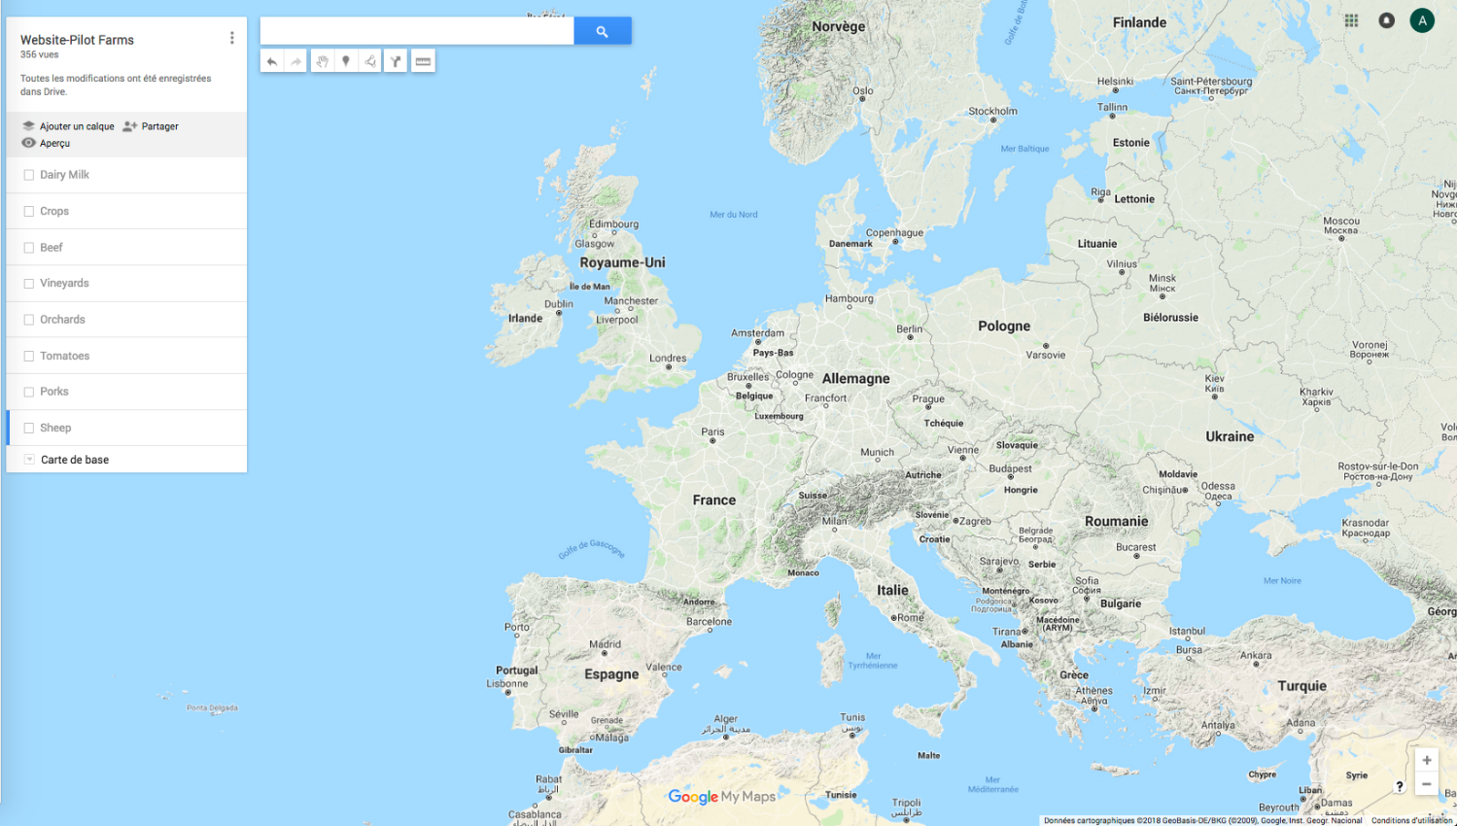
Climate observations

Slide 32
Climate observations

Slide 33
Climate observations

Slide 34
Climate observations

Slide 35
Climate observations

Slide 36
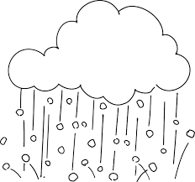
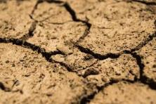
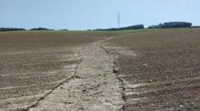

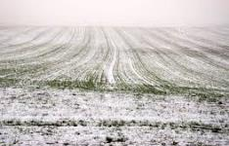
Climate events at farm level
Hail
Spain France Germany Estonia
Regular for 75% of the cereal farms & impacts very variable (5%-50%)
Problematic for permanent crops, 30% frequency with very high impact
60 % of the farms concerned, mostly frequency of 10 %. Some farms frequency of > 70%. Damages very variable (10 – 80%)
Frequency 22% on average (0-50%), Impact 19% on average (2-60%)
80% concerned but regular only for ¼ farms and impacts very variable (5% to 100%)

Slide 37

Climate events at farm level
Intense/late frost
Spain France Germany Estonia
Cereal crops: regular for the 75% of the farms, impacts very variable
(30%-70%)
Permanent crops:
lower frequency - variable impact
23 % of farms concerned. Low frequency but especially damaging for permanent crop farms
Frequency 30% on average (10-100%), impact 29% (5-100%)
93% concerned.
Low frequency but significant impacts.

Slide 38

Climate events at farm level
Drought
Spain France Germany Estonia
More frequent and potential significant impacts (20-100%).
First limiting climate factor for permanent crops & dehesa
Early summer drought increasing problem with frequencies of 40 – 50%). 50 % of the farms concerned with drought in general.
Frequency 27% (10-100%), impact 10% (5-35%).
60% concerned.
More frequent and potential significant impacts.

Slide 39

Climate events at farm level
High temperatures
Spain France Germany Estonia
High frequency.
Significant impacts for animals, permanent crops, tomatoes.
Only 20 % of farms stated as a concern, but in reality nearly 100 % of the farms concerned. Frequencies of 40 %.
Frequency 17% (10-20%), impact 21% (10-30%).
78% concerned.
More frequent but punctual impacts.

Slide 40
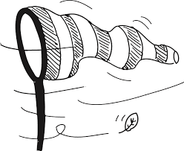

Climate events at farm level
Spain France Germany Estonia
Arable crops: storms in June and July, impacts between 5-30%
Tomatoes: high precipitation in April and May.
Wet springs are especially a concern for maize.
Winterkill was a problem in 2012 for cereal farms.
Lack of sunshine (15% frequency)
Wind damage: frequency 15% (5-30%), impact 11% (5-15%).
North of France: intense rainfall in 2016, -50% yield
South of France: wind increase with

Slide 41
Crop yield variability - Spain

Slide 42
Crop yield variability - France

Slide 43
Crop yield variability - Germany

Slide 44
Crop yield variability - Estonia

Slide 45
Climate projections

Slide 46
Climate projections

Slide 47
Climate projections - Cereals

Slide 48
Climate projections - Cereals

Slide 49
Climate projections - Animals

Slide 50
Climate projections - Vineyards

Slide 51
Climate projections - Vineyards

Slide 52
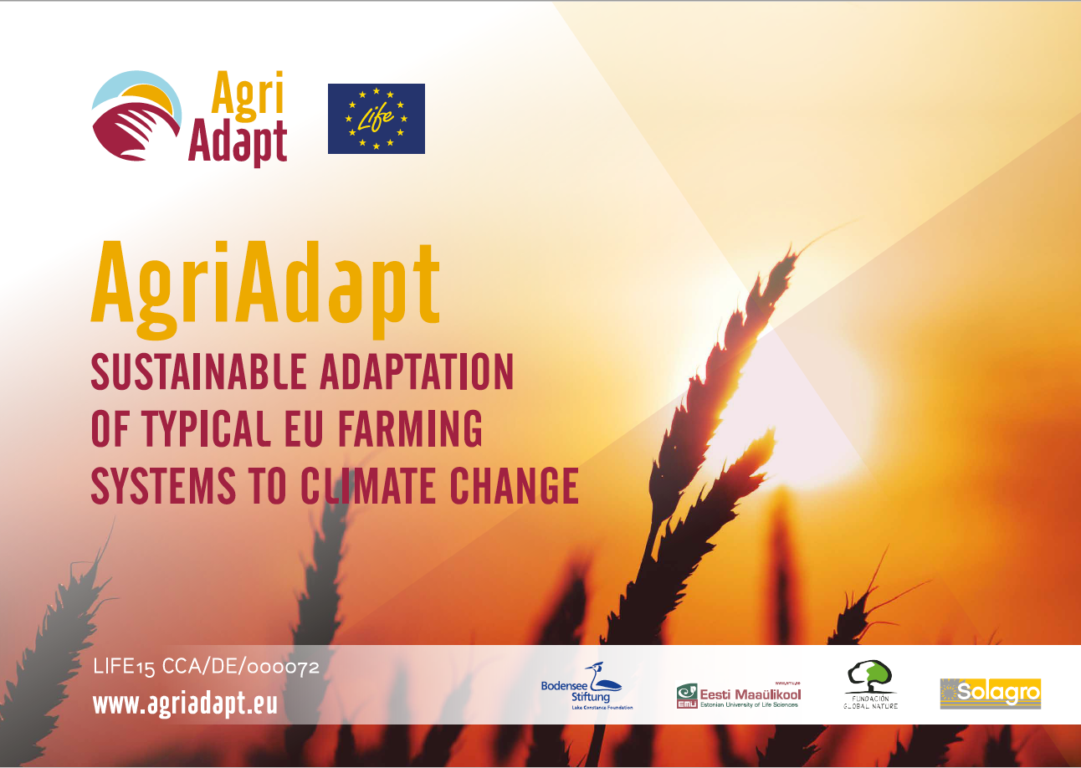
Thanks for your attention

