Slide 1
Sustainable Adaptation of EU Farming
Systems to Climate Change
Monday, 15th October 2018

Slide 2
Recommendations to Reduce the
Farm Climate Vulnerability
in the Southern Climate Zone

Slide 3
Southern climate zone SWOT
STRENGTHS
Agricultural insurance
High professionalized crops (horts)
Adaptation options already in place
WEAKNESSES
Varieties adapted to CC
Diversified crops, extensive agroforestry systems. Agroecology.
Water: long-term availability? Deficit irrigation necessary
High dependence on Monoculture
Insufficient management of Grasslands
OPPORTUNITIES
Quality more than quantity
Innovative solutions to increase water availability in soils
Varieties more tolerant to heat stress
More temperature and fewer frost days: new crops?
THREATS: limits for some crops
Heat waves in summer
Hydric deficit <-300 mm in Spring
Increase in days with Tª Max>30ºC in April and May and days >35-38ºC in summer
Less rainfall in Winter-spring

Slide 4
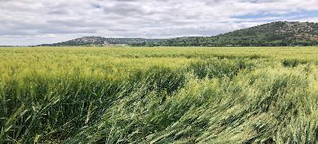
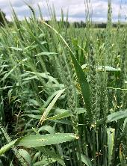
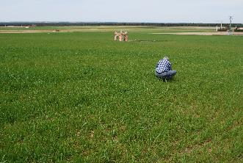
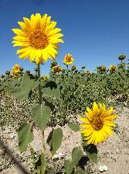
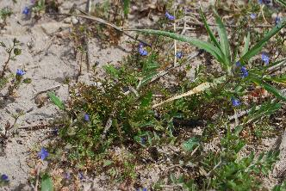
Recommendations for arable crops
Create a varietal bouquet
Diversify crops and rotations to avoid main climate stress
Improve soils
Comfort or Deficit irrigation
Hedgerow and flower strips plantations
Notes:
Create a varietal bouquet:
Earlier sowing of long cycle varieties
If not enough rainfall in autumn then a spring crop (Short cycle varieties)
Diversify crops and rotations to avoid main climate stress:
Richer rotations, including legumes
Avoid monocultures , new varieties adapted to heat stress
Improve soils:
More organic matter in the soil
Better soil structure
Comfort or Deficit irrigation
Hedgerow and flower strips plantations

Slide 5
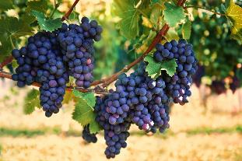
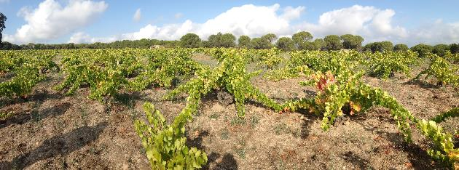
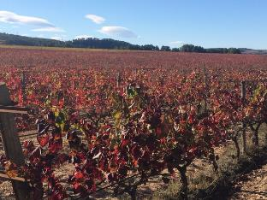
Recommendations for vineyards
Use traditional varieties
Focus on Quality (wine production) and not quantity
Prune in green to balance leaf surface and number of bunches
Improve soils
Notes:
Use traditional varieties:
Better adapted
More stable yields, even under critical conditions
Increasing interest for these varieties
Focus on Quality (wine production) and not quantity
Increase competitiveness by processing and not just producing, yield is a secondary aspect when quality is upfront
Prune in green to balance leaf surface and number of bunches:
I.e. Prune excessive vegetative growth in very wet springs,
prune bunches/canopy if they year is very hot to avoid transpiration or an excessive effort of the plant
Improve soils:
More organic matter in the soil
Better soil structure and quality

Slide 6
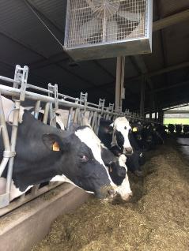
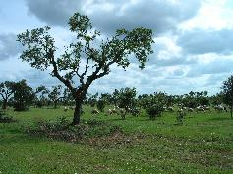
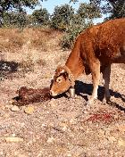
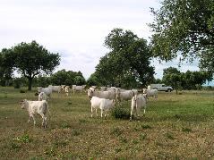
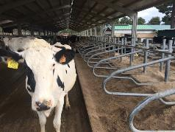
Recommendations for livestock farms
DAIRY:
Fodder autonomy and diversification.
Balance farmland surface and number of animals.
Infrastructures designed to ensure passive ventilation
Active ventilation systems.
Appropriate density of animals in buildings
EXTENSIVE BEEF (DEHESAS)
Grazing management plans to increase quantity and quality of pasture
Native seeds sowing for pasture improvement
Keyline design to maximize beneficial use of water resources
Notes:
DAIRY:
Fodder autonomy and diversification.
Balance farmland surface and number of animals.
Modification in the design of infrastructures to ensure passive ventilation (completely open barns, optionally closed in winter using straw bales or similar movable structures). Active ventilation systems.
Appropriate density of animals in buildings
EXTENSIVE BEEF (DEHESAS)
Grazing management plans to increase quantity and quality of pasture based on the time needed to recover the pasture.
Native seeds sowing for pasture improvement
Keyline design to maximize beneficial use of water resources (rainfall infiltrates the soil).

Slide 7
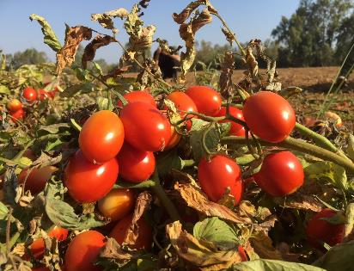
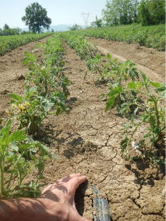
Recommendations for processing tomatoes
Efficient irrigation: better and more efficient system for irrigation to avoid water spillage.
Improve soils
Varieties selection (most adapted)
Diversify crops and rotations to avoid main climate stress
Notes:
Efficient irrigation: better and more efficient system for irrigation to avoid water spillage.
(=decision-support tools for irrigation) including water meters, tensiometric probes, on-site meteorologic stations, etc.
Improvement of water transport infrastructures for avoiding water spillage
Better knowledge of water needs specifically for the crop
Improve soils:
Improving soil structure to increase water infiltration capacity and avoid evapotranspiration losses.
Varieties:
selection of most suitable varieties.
Diversify crops and rotations to avoid main climate stress:
Richest rotations.
Winter crops.

Slide 8
Recommendations to Reduce the
Farm Climate Vulnerability
in the Atlantic Climate Zone
8

Slide 9
Atlantic climate zone SWOT
STRENGTHS
Fodder management (diversity, stocks, etc.)
WEAKNESSES
Inadequate crops cultivated and/or low genetic diversity
OPPORTUNITIES
Trend for better crops climate conditions in autumn
THREATS
Trend for more yields impacts due to May/June climate stress
Irrigation restriction dependency
Significant decline of the nb frost days/year
New crops possibilities through the increased of GDD
Increase in heat stress for animals
Irrigation (limitation of year to year yields variability)
Diversified cropping systems
Insufficient animal thermal comfort
Increase of hydric deficit in spring and summer

Slide 10
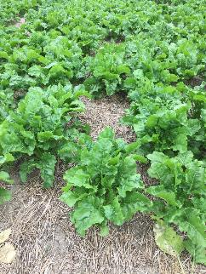
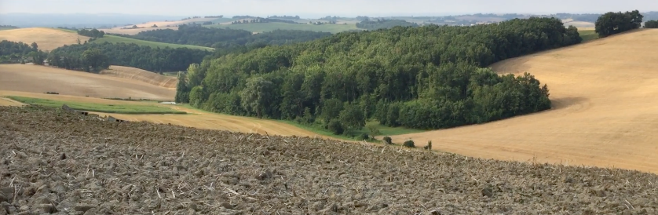
Recommendations for arable farms
Cropping system
Crops number
Crops complementary
Anticipate the soil water content of the different plots
Intermediate crops as “climate protection”
Main crops
Comply with a varieties threshold/ha
Expand the varieties spectrum
Irrigation
Water efficiency
Dodge strategies (early sowing)
Substitution of crops irrigated

Slide 11
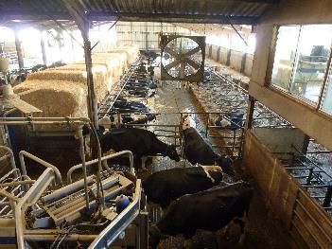
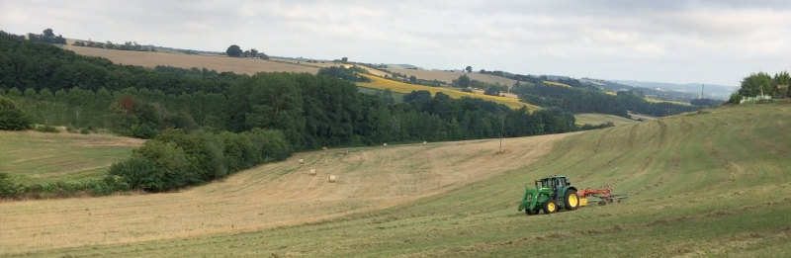
Recommendations for livestock farms
All actions that secure the farm fodder autonomy
Grassland management
Nb fodder components
Adapted varieties
Contractualization for external fodder
Reasonable livestock stocking rate
Animals thermal comfort
Hedges plantation around pastures and buildings, shelters in grasslands
Specific investment in buildings
Management practices
Watering / heatwaves
Feeding adaptation (time, composition, etc.)

Slide 12
Recommendations to Reduce the
Farm Climate Vulnerability
in the Continental Climate Zone
12

Slide 13
Continental climate zone SWOT
STRENGTHS
All farms use catch crops before spring crops (minimum of bare soil)
WEAKNESSES
High share of one specific crop
OPPORTUNITIES
Opportunity for new crops or varieties
THREATS
Higher variability in yields
Income from various pillars
Dairy farms have high fodder independence
Especially dairy farms have only 3 crops in crop rotation
Ploughing main soil tillage management
Longer vegetation period positive for grassland & tuber crops
Reduction of moisture loving pathogens
Increase in heat stress for dairy cows
Risk of new pests/diseases due to higher temperatures & longer vegetation period
Notes:
The strengths in the continental region are slightly different than in the previous climate zones.
All farms use catch crops before spring crops to minimise the amount of bare soil. The income of the farms is mostly spread over various pillars (reducing the risk) and dairy farms have a high fodder independence.
A high share of one specific crop (specialisation) seems to be an overall weakness of the farms in Europe. Many of the farms in the continental climate still plough as their main tillage management and especially dairy farms don´t have a diverse crop rotation.
Opportunities of climate change also exist in the continental climate zone: there is the opportunity of new crops/varieties (Soy, sunflower or forgotten crops such as camelina).
Longer vegetation periods have a positive effect on grassland yields, and moisture loving pathogens may decrease.
Threats resulting from climate change are as in the other regions a higher variability in yields, increased heat stress for dairy cows and in contrast to the opportuinity before, a risk of new pests and diseases.

Slide 14
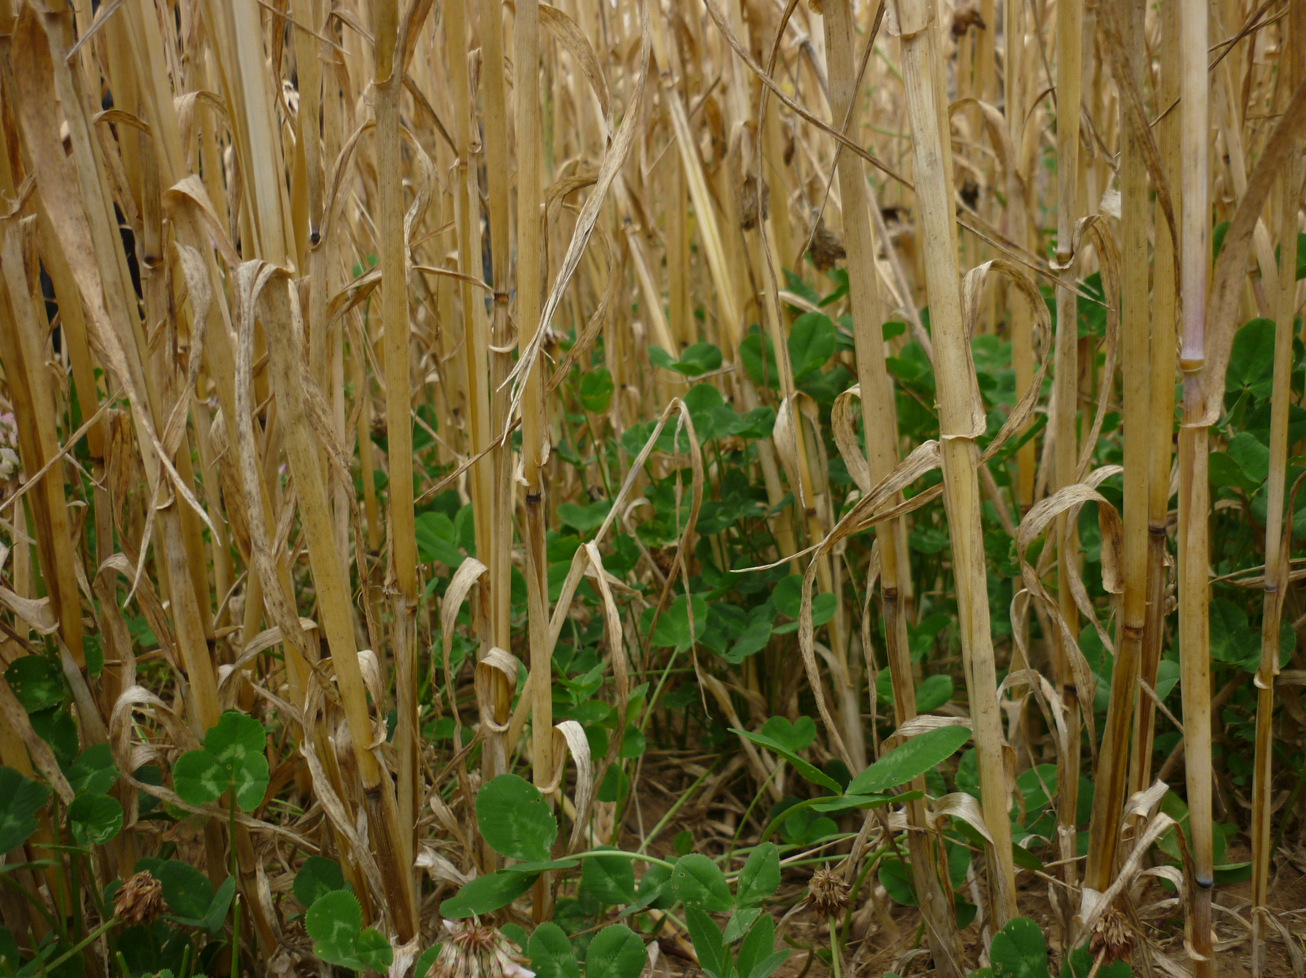
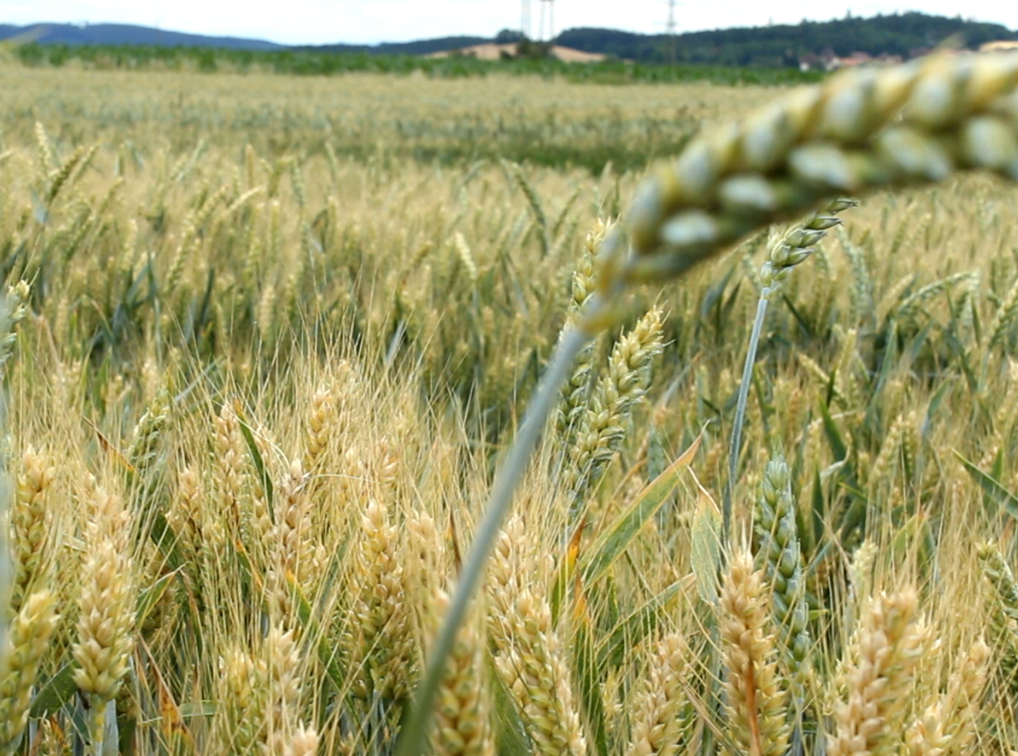
Recommendations for arable farms
Wider crop rotations
Improves soil fertility
Spreads the risk
Less risk of pests and diseases
Undersowing
Improves soil fertility
Reduces soil erosion
Reduces soil compaction
Mixed intercropping
Improves soil fertility
Spreads the risk
Less risk of pests and diseases
Higher nutrient availability
Notes:
From our work on the pilot farms, we have summarised a set of adaptation measures which have shown to be practicable.
One of the main things which reduces the vulnerability to climate change and is sustainable is the improvement of soil quality. This can be done by all of the following measures (which also have other benefits).
Wider crop rotations
Undersowing – seen in the picture
Meslins: Unterschiedliche Wurzelausscheidungen

Slide 15
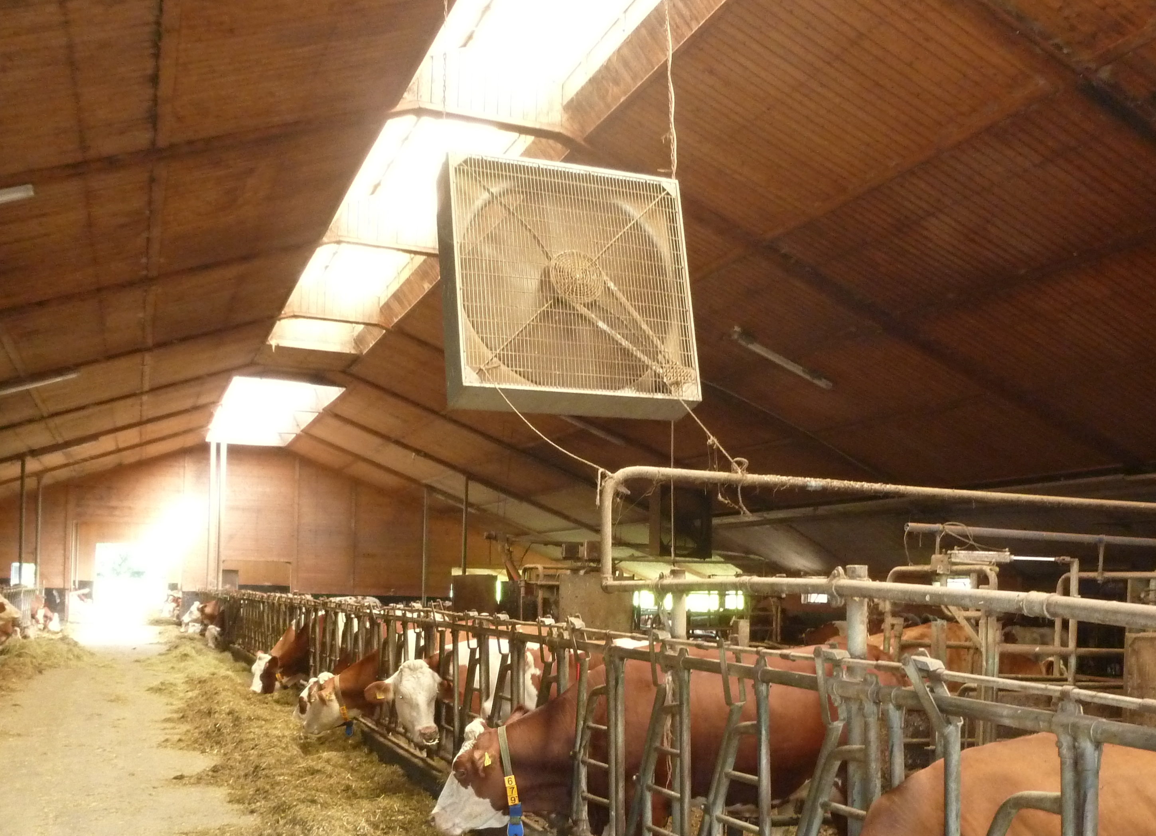
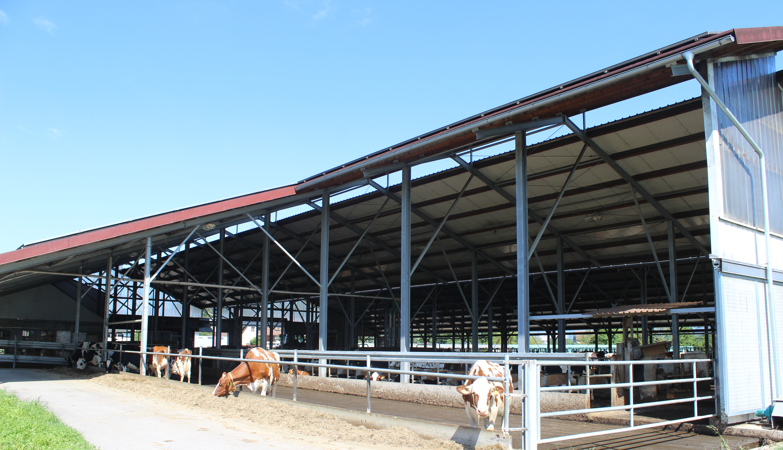
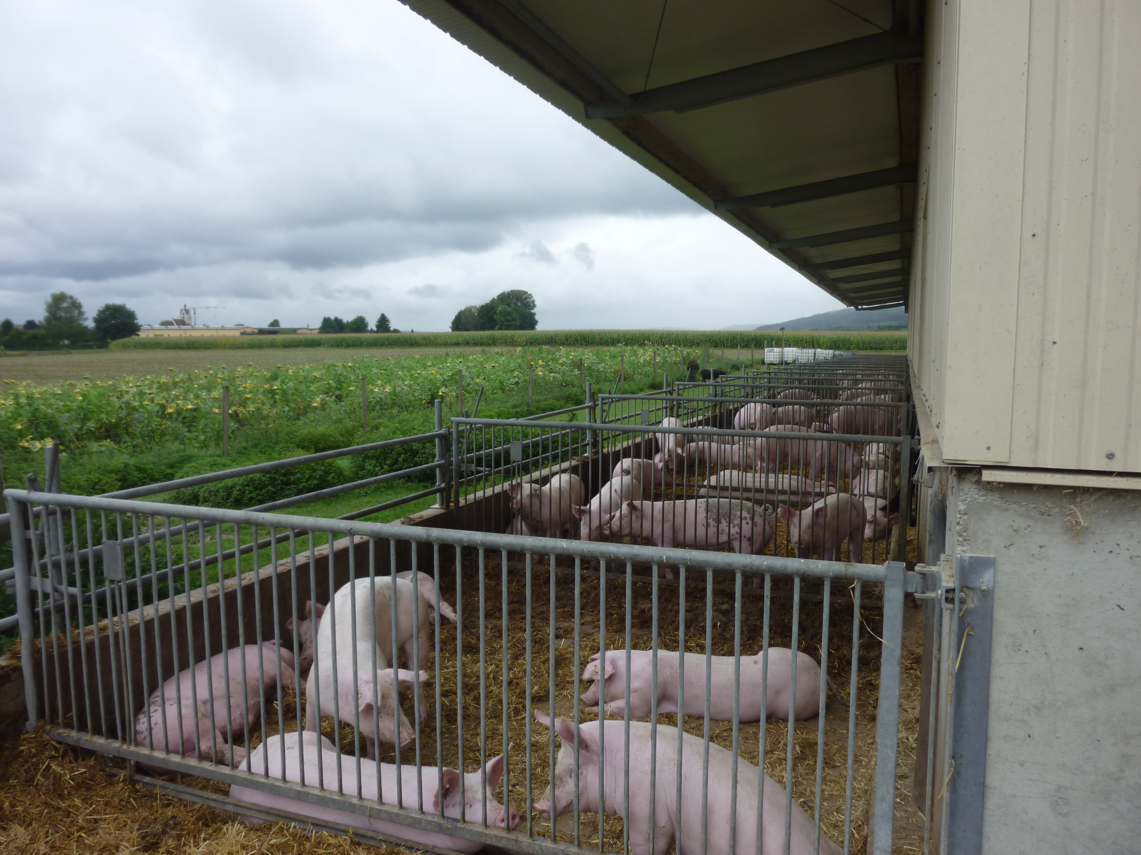
Recommendations for livestock farms
Reduce heat stress
Additional ventilation / Improved cooling system
Open barns / Barns with outdoor access
Decrease animal density
High water availability (barn & meadow)
Introduce clover grass into crop rotation
Improves soil fertility
Increased flexibility compared to grassland
Protein crop
Nitrogen fixation

Slide 16
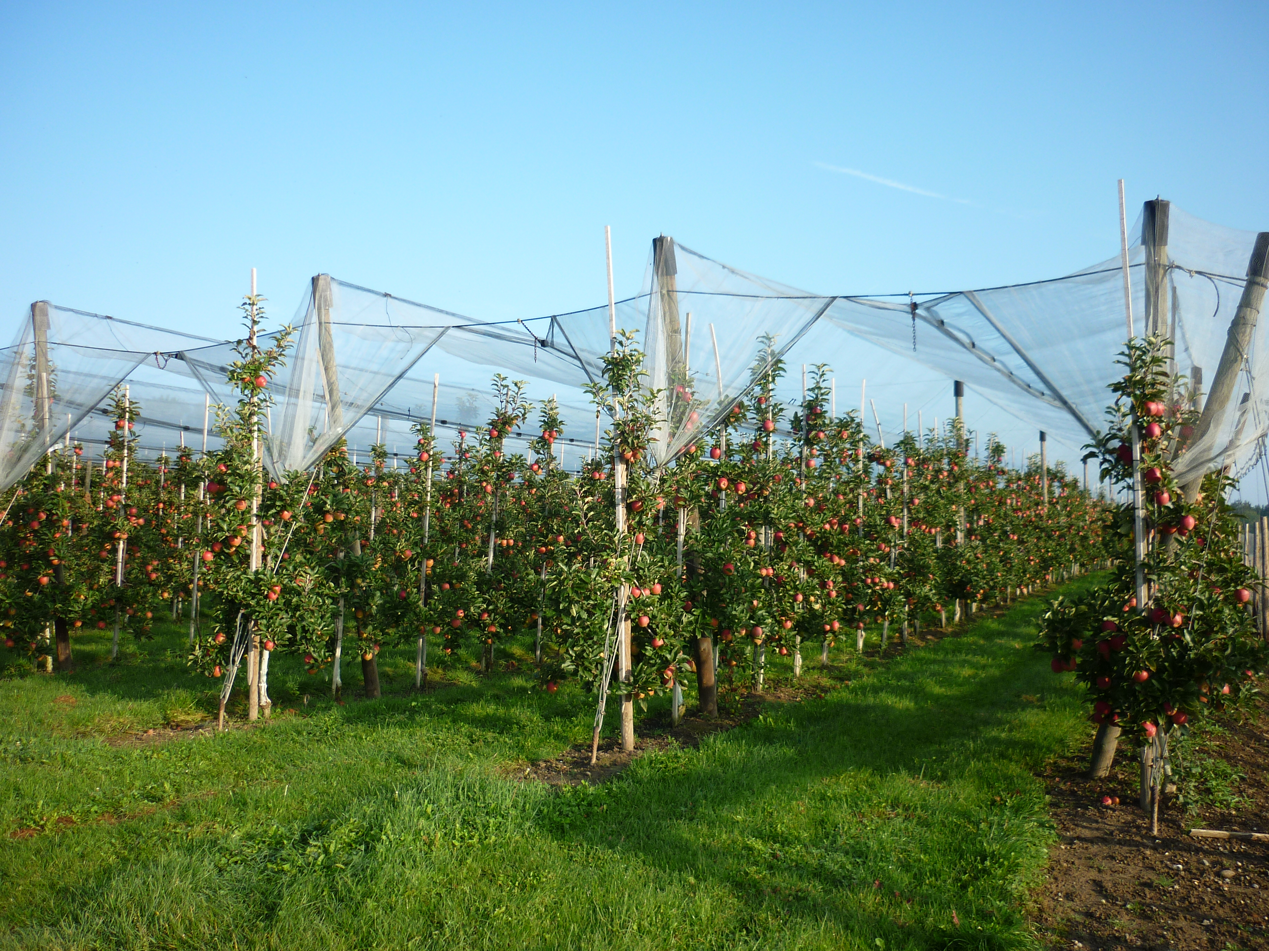
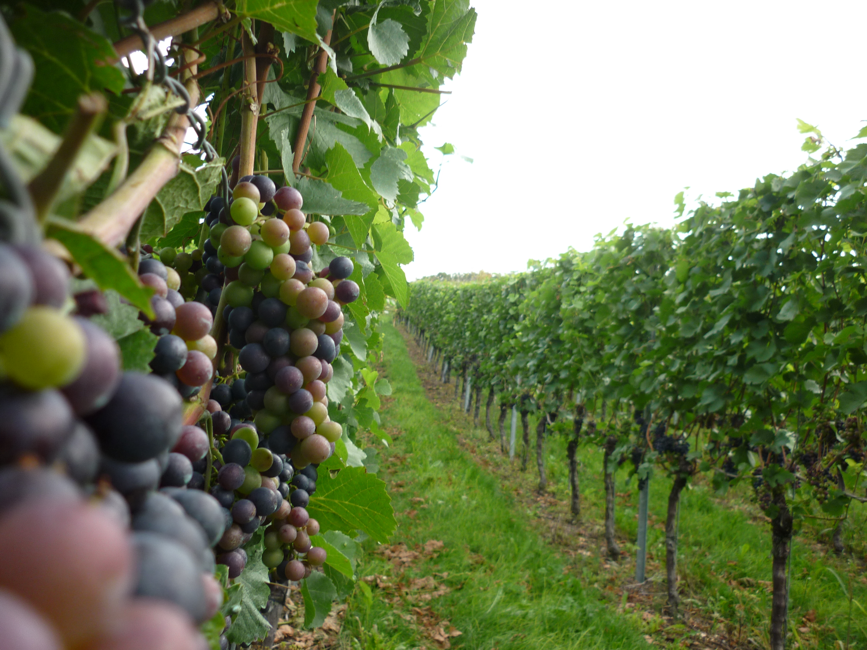
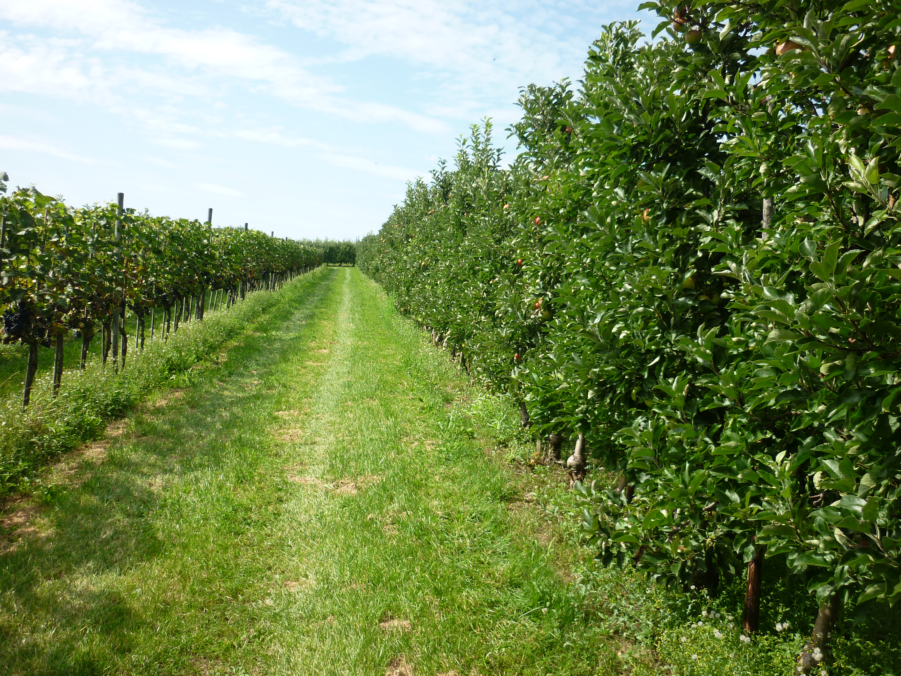
Recommendations for permanent crop farms
Hail protection nets
Higher quality and quantity
Reduces radiation and therefore sunburn
Biodiverse ground cover
Increases water availability
Reduces soil erosion
Increases amount of beneficial insects
Regional wild plants reduce water competition with permanent crop

Slide 17
Recommendations to Reduce the
Farm Climate Vulnerability
in the Northern Climate Zone
17

Slide 18
Northern climate zone SWOT
STRENGTHS
WEAKNESSES
Permanent crops: no irrigation used
OPPORTUNITIES
Permanent crops: irrigation systems
THREATS
Permanent crops: more climatic extremes expected
Arable crops: range of varieties grown, agrotechnological flexibility
Animals: high fodder autonomy
Permanent crops: high crop diversity and suitable soils
Arable crops: availability of suitable fallow fields
Animals: poor soil drainage
Arable crops: cultivation of green manure and intercrops to improve soil quality and improve the availability of fallow.
Animals: improve soil drainage system
Arable crops: increasing risk of new pests and diseases with new cultivars
Animals: lower performance due to heat stress, especially outdoors

Slide 19
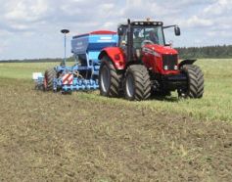
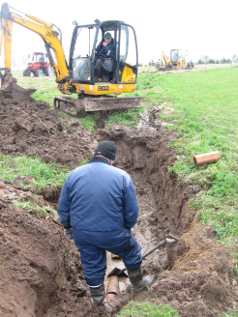
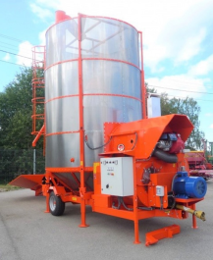
Recommendations for arable farms
Improve soil management
suitable tillage methods
soil drainage system
using green manure, nitrate catch crops and other organic amendments
Use suitable varieties
winter hardy varieties
novel crops (soya, oil canopy, etc.)
Increase harvesting and grain drying capacity
to be ready for wet harvesting periods
to minimise grain/economical losses
to ensure grain quality
Photo: Hannes Puu

Slide 20
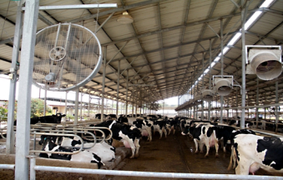
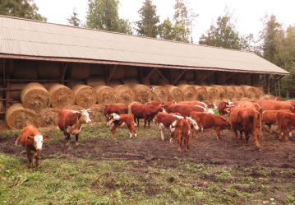
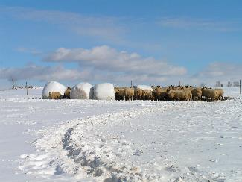
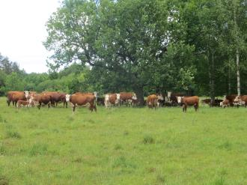
Recommendations for livestock farms
Reduce heat/cold stress
invest to cooling system in dairy
provide different shelters for outdoor animals during summer and winter
Increase fodder storage
to be used during unfavourable weather periods
to avoid unwilling animal slaughter/culling
improve soil drainage to avoid flooded areas
http://www.panddsales.com/equipment/cooling.html

Slide 21
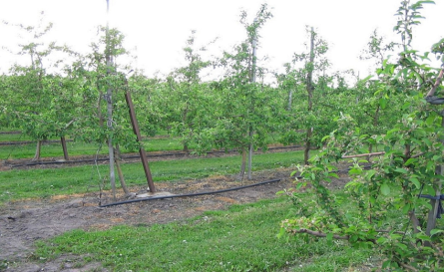
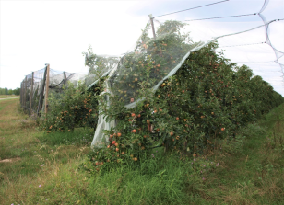
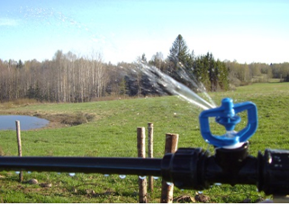
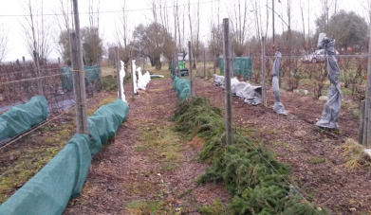
Recommendations for permanent crop farms
Need for irrigation systems
apple, plum, blueberry, currants
frost protection by sprinklers
Hail/frost protection covers
winter covers for grapes
spring/autumn covers for grapes
or plastic tunnels

Slide 22
Thanks for your attention

