Slide 1

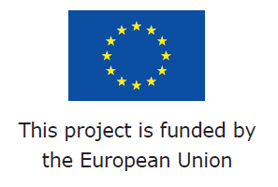
RAIN - Risk Analysis of Infrastructure Networks in Response to Extreme Weather
RAIN Final Conference
Regent House, TCD,
Dublin, Ireland
24th March 2017
Prof. Alan O’Connor
Dept. of Civil Engineering, Trinity College Dublin
alan.oconnor@tcd.ie
www.rain-project.eu

Slide 2
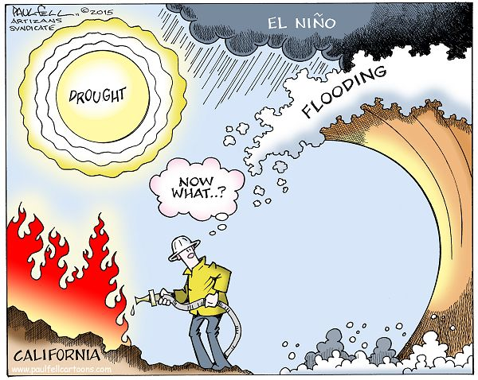

Slide 3
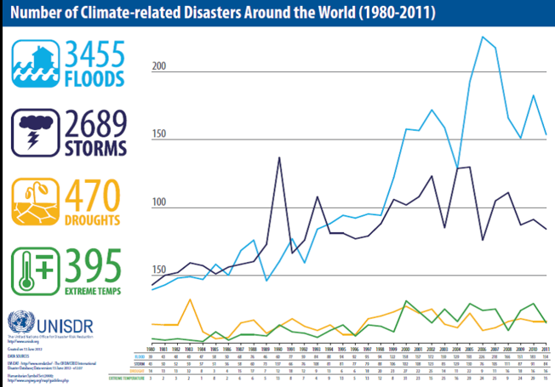

Slide 4
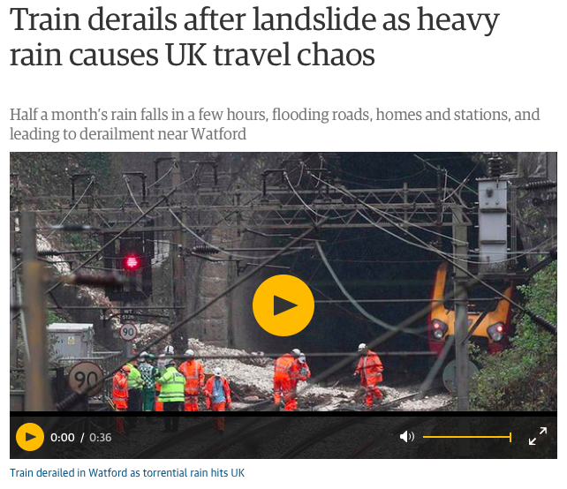
https://www.theguardian.com/uk-news/2016/sep/16/torrential-rain-travel-chaos-england-floods

Slide 5
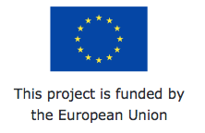
Introduction
Project RAIN – Risk Analysis of INfrastructure Networks in Response to Extreme Weather
FP7 Theme 10 - Security Activity - 10.2 Security of Infrastructures and Utilities SEC-2013.2.1-2 - Impact of Extreme Weather on Critical Infrastructure'.
  'Activities will concentrate on targets of an incident or disaster of transnational importance…, significant sites of political or symbolic value and utilities being those for energy (including oil, electricity, gas), water, transport (including air, sea, land), communication (including broadcasting), financial, administrative, public health, etc.
  A series of capabilities are required to cope with this mission area, many of which primarily relate to the phases "protect" but also "prepare”.

Slide 6
Introduction
  The ambition is both to avoid an incident and to mitigate its potential consequences.
  emphasis will be on issues such as: analysing, modelling and assessing vulnerabilities of physical infrastructure and its operations; securing existing and future public and private critical networked infrastructures, systems and services with respect to their physical, logical and functional side; control and alert systems to allow for quick response in case of an incident; protection against cascading effects of an incident, defining and designing criteria to build new secure infrastructures and utilities.'

Slide 7
RAIN Vision
  To develop a systematic risk management framework that explicitly considers the impacts of extreme weather events on critical infrastructure and develops a series of mitigation tools to enhance the security of the pan-European infrastructure network.
  To do this we must:
  quantify the complex interactions between weather events and land based infrastructure systems (i.e. transport, telecoms, energy etc.),
  develop an operational analysis framework that considers the impact of individual hazards and the coupled interdependencies of critical infrastructure through robust risk and uncertainty modelling,

Slide 8
interactions between weather events and land based transportation systems
(source: Makkonen, Törnqvist and Kuusela-Lahtinen, VTT)

Slide 9
RAIN Vision
  To develop a systematic risk management framework that explicitly considers the impacts of extreme weather events on critical infrastructure and develops a series of mitigation tools to enhance the security of the pan-European infrastructure network.
  To do this we must:
  quantify the complex interactions between weather events and land based infrastructure systems (i.e. transport, telecoms, energy etc.),
  develop an operational analysis framework that considers the impact of individual hazards and the coupled interdependencies of critical infrastructure through robust risk and uncertainty modelling,

Slide 10
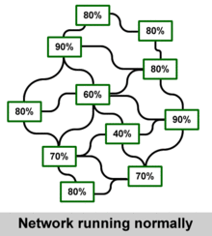
RAIN Vision
  considering cascading hazards, cascading effects and time dependent vulnerability
  Develop Technical and Logistic solutions to minimise the impact of these extreme events, include novel early warning systems, decision support tools and engineering solutions to ensure rapid reinstatement of the infrastructure network
Network Performance

Slide 11
Context
  In recent years, the complex interdependencies of the European/International infrastructure networks have been highlighted through multiple failures during extreme weather events. These failures have been the driver for this project, e.g.
  Hurricane and Severe Storm damage (2012) - Hurricane Sandy - largest Atlantic storm on record devastated portions of the Caribbean, Mid-Atlantic and North Eastern United States
  193 people were killed along the path of the storm in seven countries
  damage >$20 billion(USD) losses (including business interruption) > $50 billion
  Jamaica: winds left 70% of residents without electricity, blew roofs off buildings, killed one, and caused about $55.23 million in damage.

Slide 12
Context
Haiti: Sandy's outer bands brought flooding that killed at least 54, caused food shortages, and left about 200,000 homeless,
Cuba: extensive coastal flooding and wind damage inland, destroying some 15,000 homes, killing 11, and causing $2 billion in damage,
United States: affected at least 24 states, from Florida to Maine and west to Michigan and Wisconsin, with particularly severe damage in New Jersey and New York.
  Its storm surge hit New York City on October 29, flooding streets, tunnels and subway lines and cutting power in and around the city.
  New York Stock Exchange remaining closed for trading for two days.
  7 subway tunnels under the East River were flooded, which the Metropolitan Transportation Authority stated early on October 30 “that the destruction caused by the storm was the worst disaster in the 108-year history of the New York City subway system”.
  Gas shortages throughout the region.

Slide 13
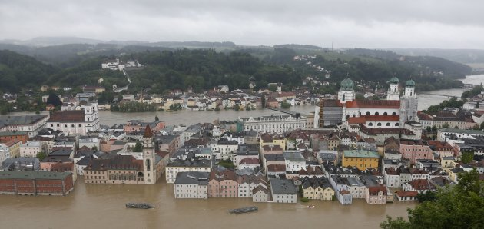
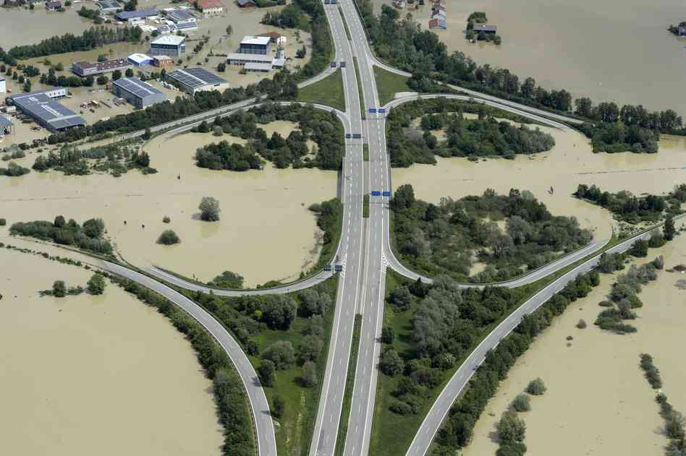
Flash Floods
Central Europe, 2002
deaths of approximately 150 people and an estimated €150 Billion worth of damage,
In Germany and the Czech Republic, the worst affected areas
  electricity failures, disconnected telecommunication links, damage to approximately 250 roads and 256 bridge structures,
  disruption to the Gas service due to damaged pipelines and contamination of clean water with flood water.
  restoration of important services to full capacity took approximately 1 month for electricity, 2 months for Gas and 3 months for telephone communications.

Slide 14
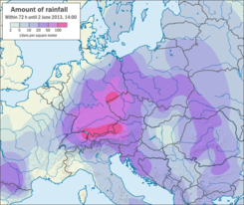
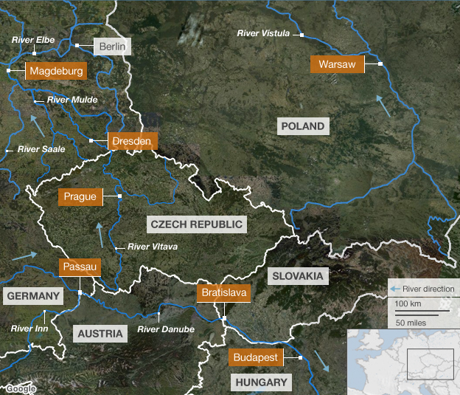
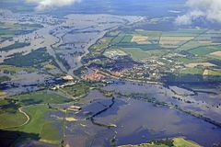
Flash Floods
Central Europe, 2013
deaths of 19 people and €bn’s worth of damage
Germany, Hungary and the Czech Republic, the worst affected areas
23,000 people leave homes in German city of Magdeburg where waters rose to 7.44m (normal 2m)!!

Slide 15
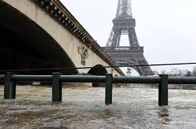
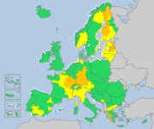
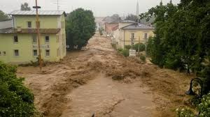
Flash Floods
Europe, 2016
deaths of 14 people (so far!) and €bn’s worth of damage!!

Slide 16
RAIN
Project Structure
Work Package Structure
WP1 – TCD
WP2 – ESSL
WP3 – UNIZA
WP4 – AIA
WP5 – TU_Delft
WP6 – ROD
WP7 – GDG
WP8 – Youris

Slide 17
RAIN Consortium

Slide 18
RAIN
Project Structure
Work Package Structure
WP1 – TCD
WP2 – ESSL
WP3 – UNIZA
WP4 – AIA
WP5 – TU_Delft
WP6 – ROD
WP7 – GDG
WP8 – Youris

Slide 19

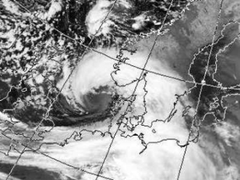
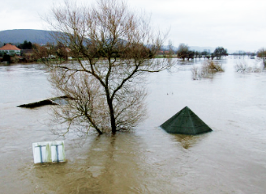
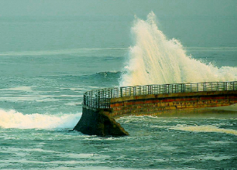
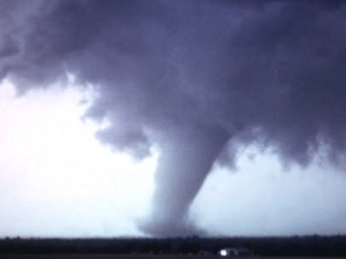
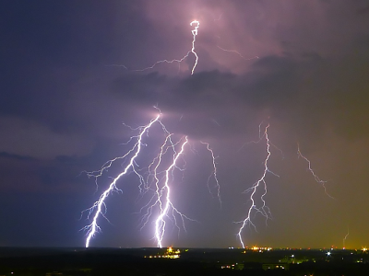
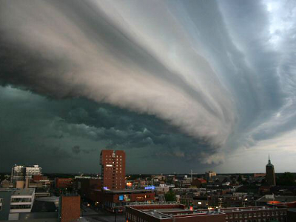
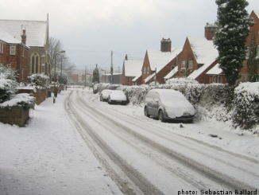
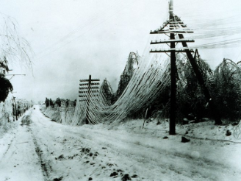
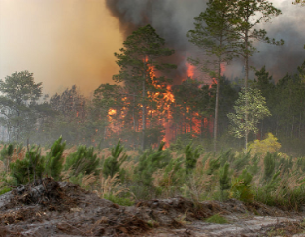
Hazard Identification
images (cc-by-sa license): thunderstorm gusts: John Kerstholt
snow storms: Sebastian Ballard, lightning: Timo Newton-Syms
heavy rain
wind storms
river floods
coastal floods
tornadoes
lightning, hail,
thunderstorm winds
snow storms
freezing rain
wildfires

Slide 20
Hazard Identification
Hazard Identification
To identify the extreme weather events to be analysed in detail in RAIN, including defining appropriate intensity thresholds, taking into account regional differences in vulnerability and climate.
To assess the present state-of-the-art forecast systems for extreme weather and their characteristics, and to address and estimate their predictive skill.
To assess the frequency of weather hazards throughout Europe for both the present and future climate; by applying state-of-the-art methods to regional (CORDEX) and global (CMIP5) climate model data until the year 2100.

Slide 21
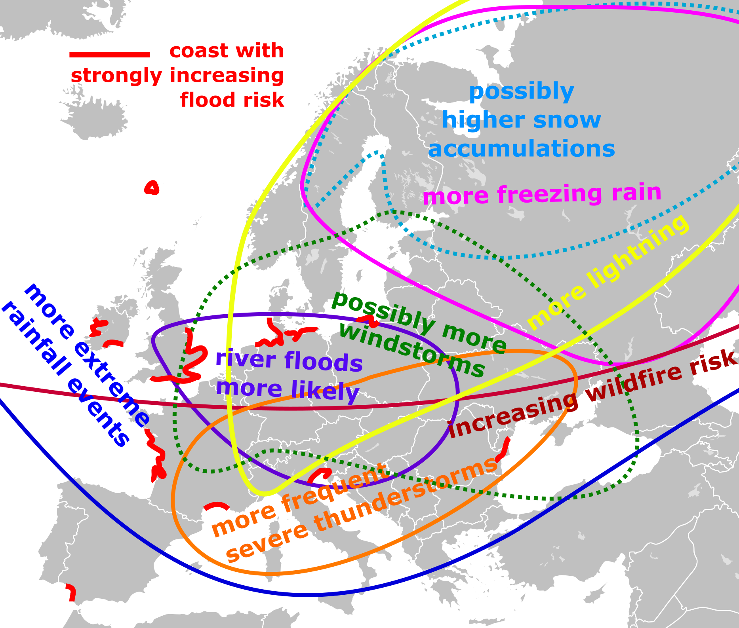
Hazard Identification
The models show different results for each considered hazard.
The modelled probabilities have been published online at TU-Delft and can be used freely by any interested party such as authorities, risk modellers, private sector
The probabilities are essential input to the RAIN Risk Based Decision Making Framework.
Notes:
21

Slide 22
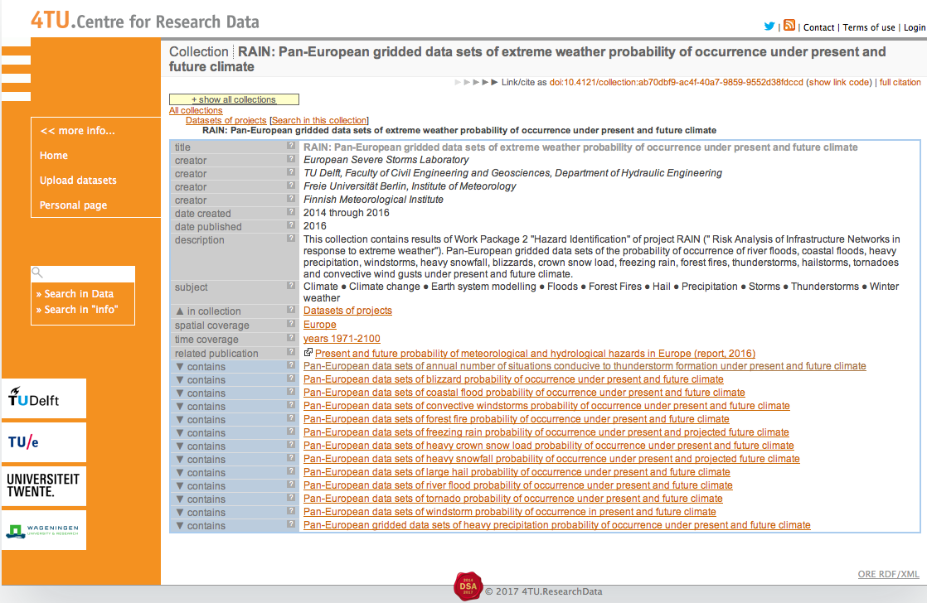
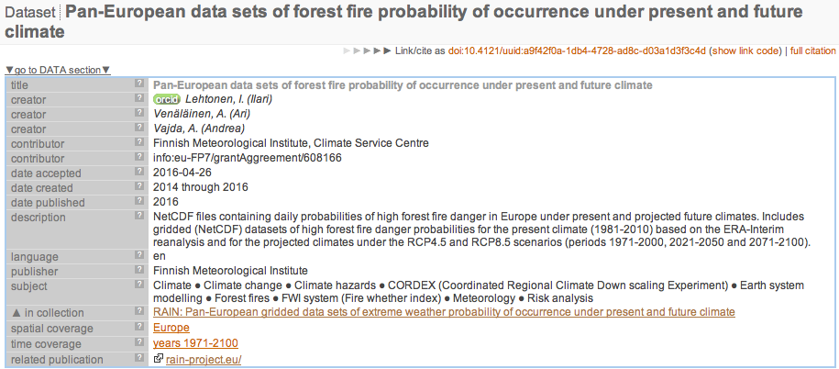
Hazard Identification
Notes:
22

Slide 23
Notes:
23

Slide 24
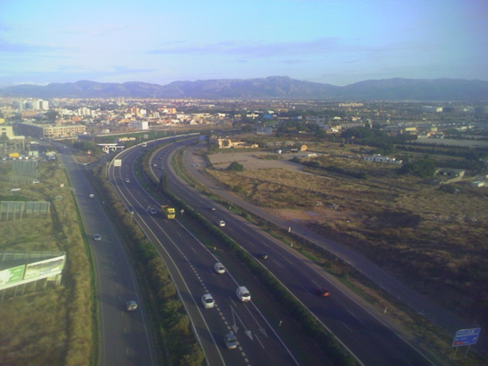
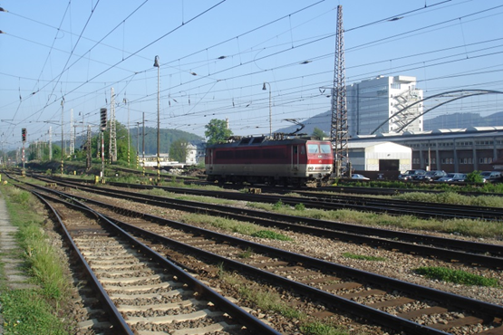
Land Transport + E&TC Vulnerability
Identify critical Land Transport + E&TC infrastructures and review their failures as caused by extreme weather events
Reviews methods for their protection
Develops an understanding on how failure of these infrastructures leads to societal vulnerability

Slide 25
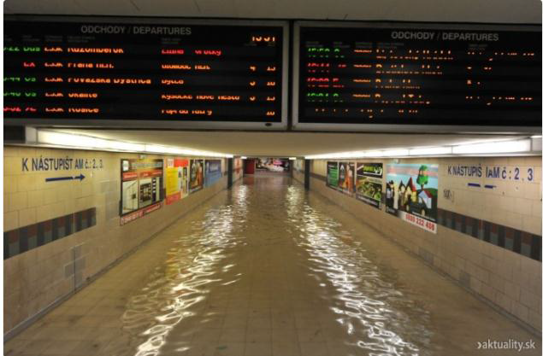
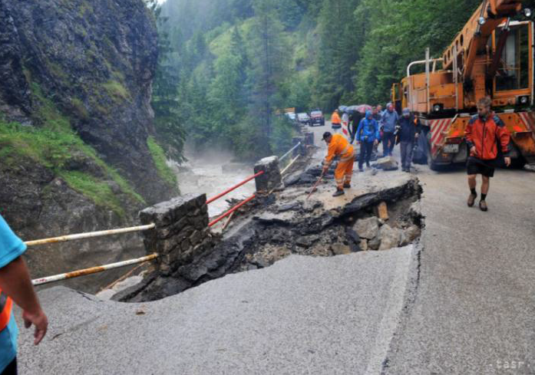
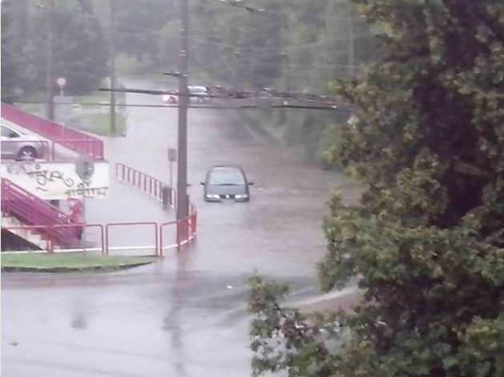
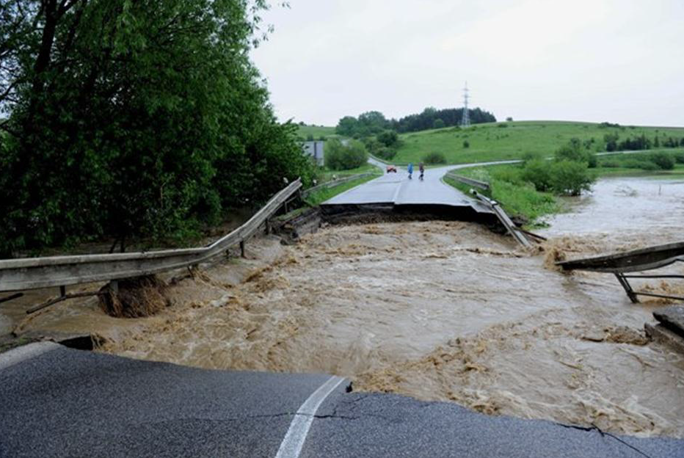
Land Transport Vulnerability

Slide 26
Land Transport Vulnerability
Vulnerability Index (VI) = f (Exposure, Susceptibility, Adaptive Capacity)
identified and described 31 indicators of societal vulnerability related to the failure of the critical land transport infrastructure elements,
facilitates understanding how failure of these infrastructures leads to societal vulnerability,
recommendations for vulnerability reduction in terms of crisis planning, risk management and preparedness enhancing are provided.
Vulnerability is:
Multi-Dimensional (e.g. physical, social, economic, environmental, institutional etc.)
Dynamic (i.e. it changes with time)
Scale-Dependent (i.e. can be expressed at different scales, from human to household to community to country)
Site-Specific

Slide 27
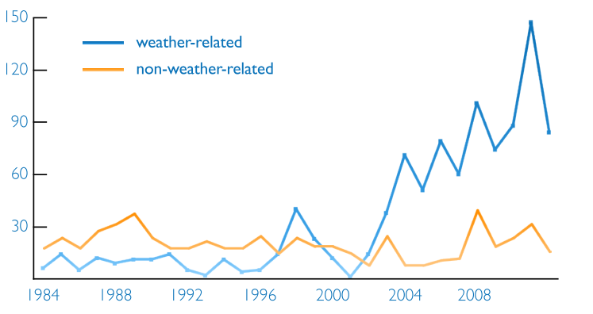
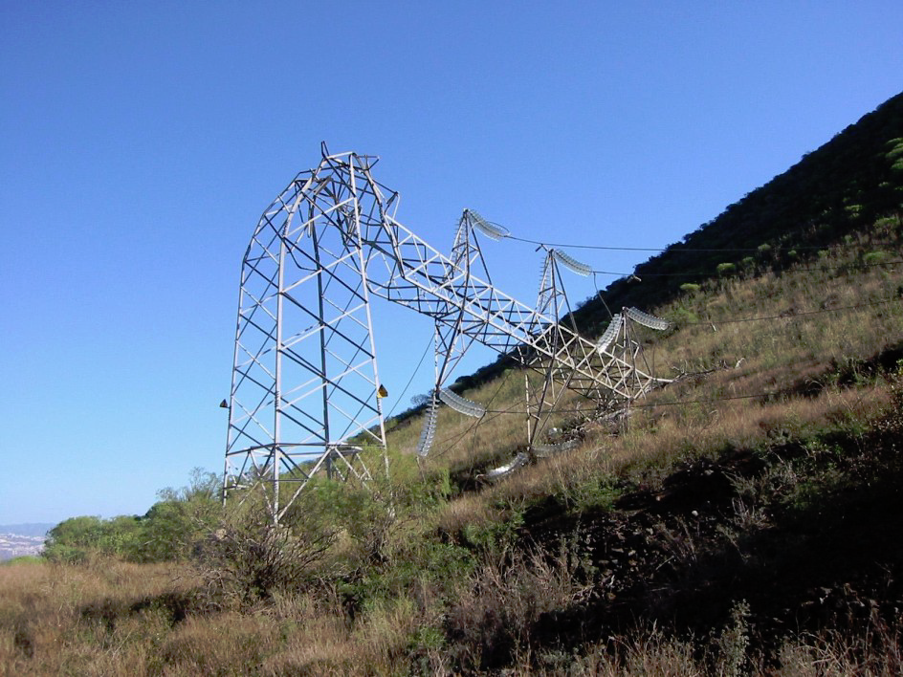
Energy & Telecoms Vulnerability
European Energy and Telecomos grids are robust and reliable, but still vulnerable to extreme weather events.
Number of power outages per year in the U.S.
Effects of tropical storm Delta
Canary Islands (Spain), 2005
2012
Foro contra la incineración de Tenerife (2005)
Kenward & Raja, Climate Central report (2014)

Slide 28
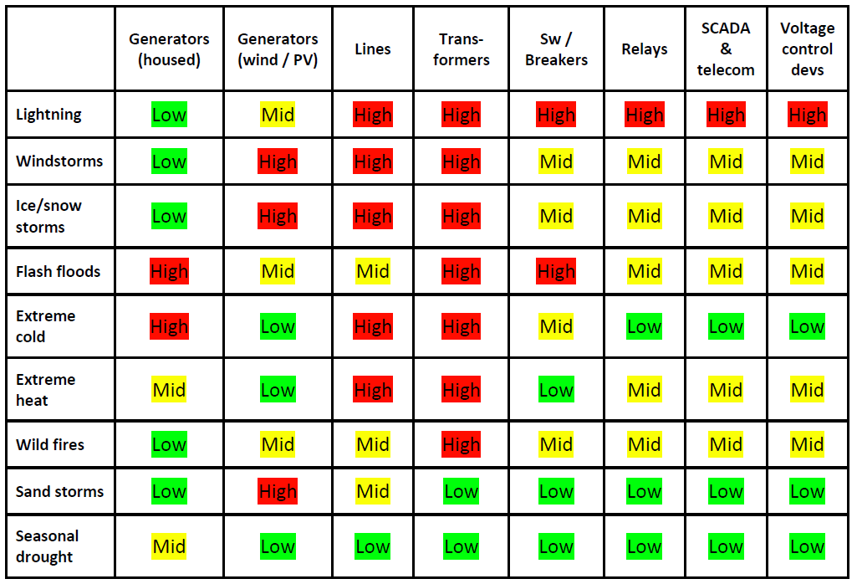
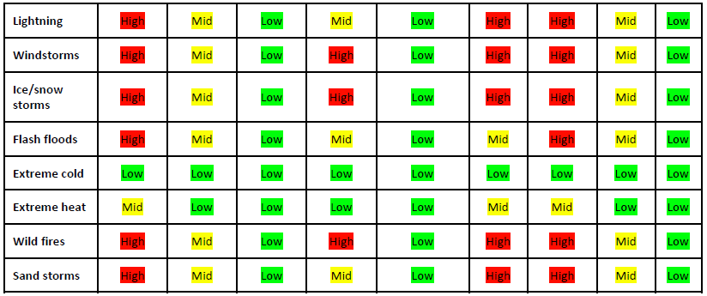
E & TC Infrastructures: Elements & Threats
Within the RAIN project:
An overall description of the Critical Infrastructures (CI) elements is provided.
The CI elements and their (weather related) threats are identified.
A first scheme of interdependencies with other CI is provided.
Threat assessment per weather threat and Telco or Electrical element:
Electrical grid elements
Telecommunications network elements

Slide 29
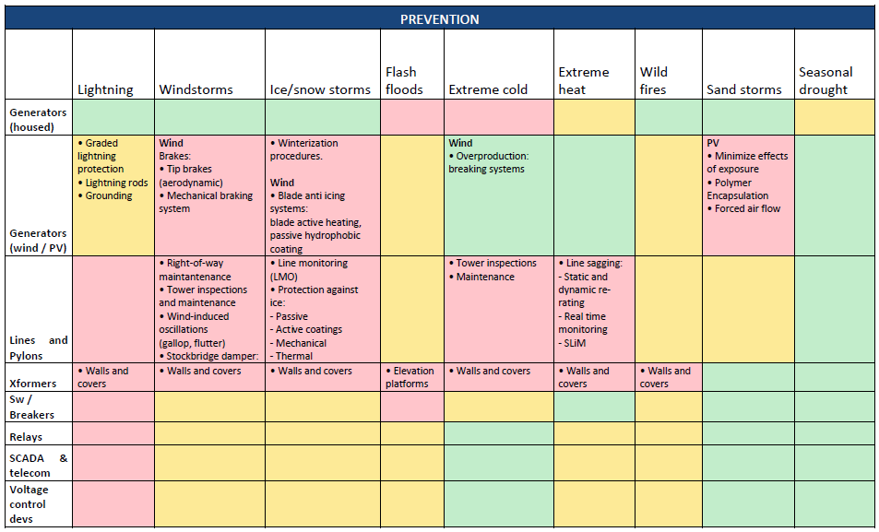
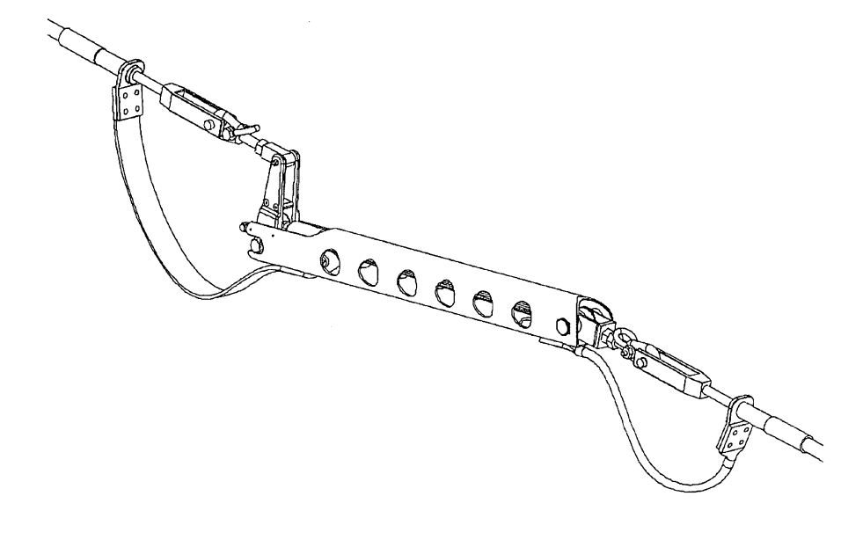
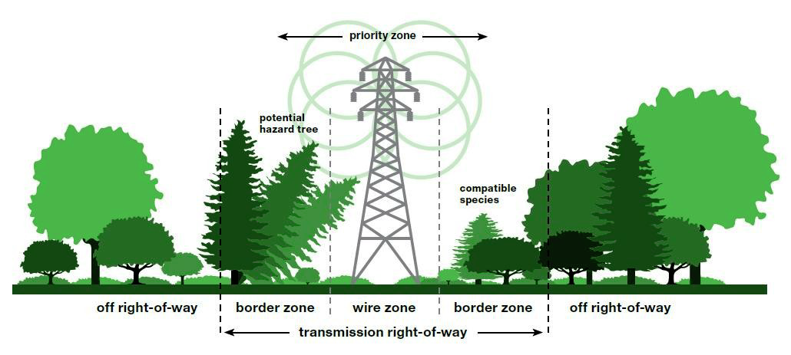
Protection of E & TC Infrastructures
Preventive and mitigation protection elements and methods to protect critical E & TC equipment against damage from extreme weather disasters infrastructure are reviewed: listed, classified by scope and type of equipment over which they act.
Line sagging mitigator
(Patent US6864421 B1)
Preventive protection measures in
electric infrastructures.
Transmission right-of-way (ConEdison)

Slide 30
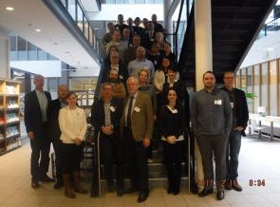
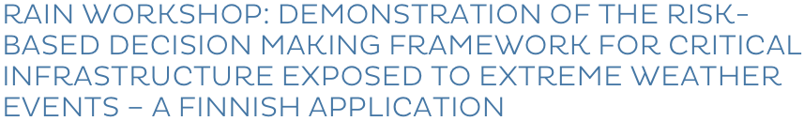
ORT Based Infrastructure Vulnerability and Resilience index
Development of a unified framework for evaluating vulnerability and resilience of critical infrastructure considering EWE’s to facilitate effective decisions on the mitigation of negative impact of EWE’s
RAIN developed a dedicated ORT-application as a proof of concept for vulnerability and resilience assessment
The ORT-application is based on the principles: Delphi-panel & Analytic Hierarchy Processing

Slide 31
Notes:
31

Slide 32
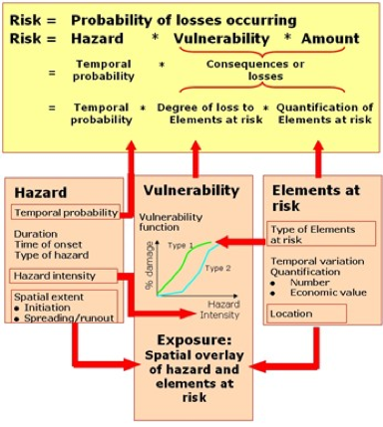
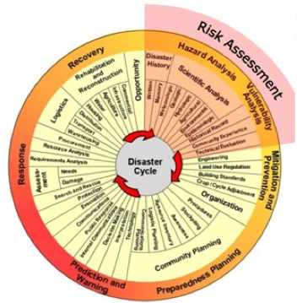
Development of a Risk Based
Decision Making Framework
To develop a risk based decision making framework for single and multiple hazard events which is also able to take into account the (collateral) impacts of cascading effects.
Source: United Nations University

Slide 33
Risk Based Decision Making Framework
Cascading Effects (temporal modelling) – Probability Sort Algorithm
Triggering Event
t₀ t₁ t₂ t₃ t₄ t₅

Slide 34
Risk Based Decision Making Framework

Slide 35
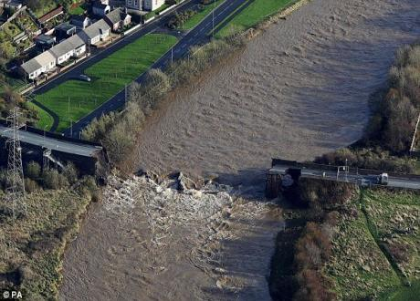
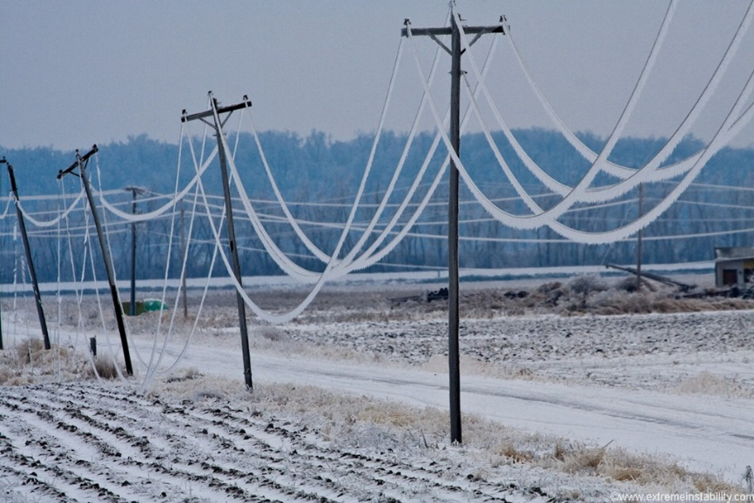
Consideration of Mitigation Measures
The project considers mitigation strategies (for land based transport and E&TC infrastructures) with a focus on measures that can be adopted to improve the risk profile of the existing infrastructure network. The objectives were to:
Develop technical, logistical and response strategies for EWE’s
Demonstrate how mitigation strategies could be incorporated into the Risk Based Decision Making Framework and
Produce recommendations on:
  Mitigation measures
  Adaption measures
  Technical Impact Matrices
  Early Warning Systems
  Policy implementation strategies

Slide 36
Application of Risk-Based Decision Making Framework
Inference Phase
Enumerate all possible hazard scenarios
Bayesian Network (BN) modelling
Quantify consequences
Land transport
Energy
Telecommunications
Quantify risk
Societal
Security
Economic
Notes:
To assist end-users in quantifying the benefits of resilient infrastructure, the risk-based decision making framework that has been proposed in RAIN was applied to two case studies.
The case studies demonstrate the implementation of this framework so that stakeholders and end-users may perform their own analyses. In keeping with the overall project focus, the case studies have focused upon extreme weather events and the potential impacts on land transport (road and rail), energy and telecommunication networks and the associated societal, security and economic risks.
Bayesian Network modelling has been employed to implement the risk-based decision framework, which consists of a simple graphical representation of the variables within a process or a network that employs Bayesian probability theory. Bayesian Network modelling facilities the combination of information from various sources (e.g. a mixture of qualitative and quantitative knowledge) and is an appropriate method for dealing with multi-disciplinary complex problems and, therefore, is well-suited for the analysis of EWE and their impacts on critical infrastructure. Furthermore, Bayesian Network modelling can be used to quantify the impact of various mitigation strategies, thereby providing a quantitative measure of resilient infrastructure.
The main steps involved in the development of a BN model are as follows:
Define the nodes (i.e. the random variables).
Construct the graph (i.e. the relationship between the various nodes or random variables).
Define possibilities (i.e. the discrete classifications) and assign probabilities to each node (or random variable).

Slide 37
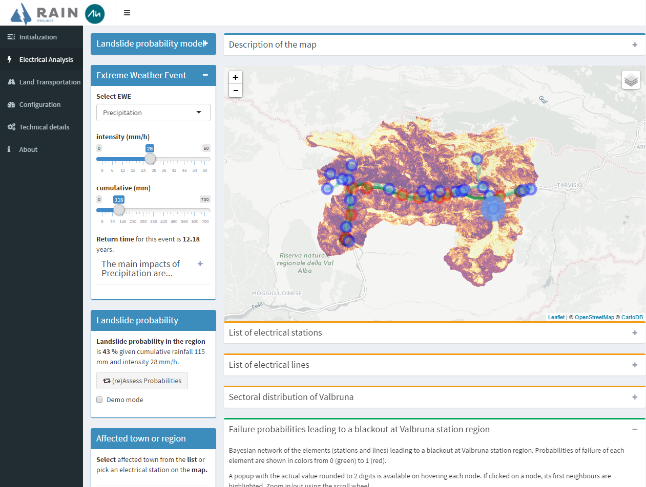
Development of a Web Based Tool for Risk-Based Decision Making
A web-tool has been developed within the RAIN project to help owners, stakeholders, policy makers etc. to make optimal decisions.
Snapshot of the main page of the webtool
https://www.youtube.com/watch?v=gM6Ugu0Fjo8

Slide 38
Notes:
38

Slide 39
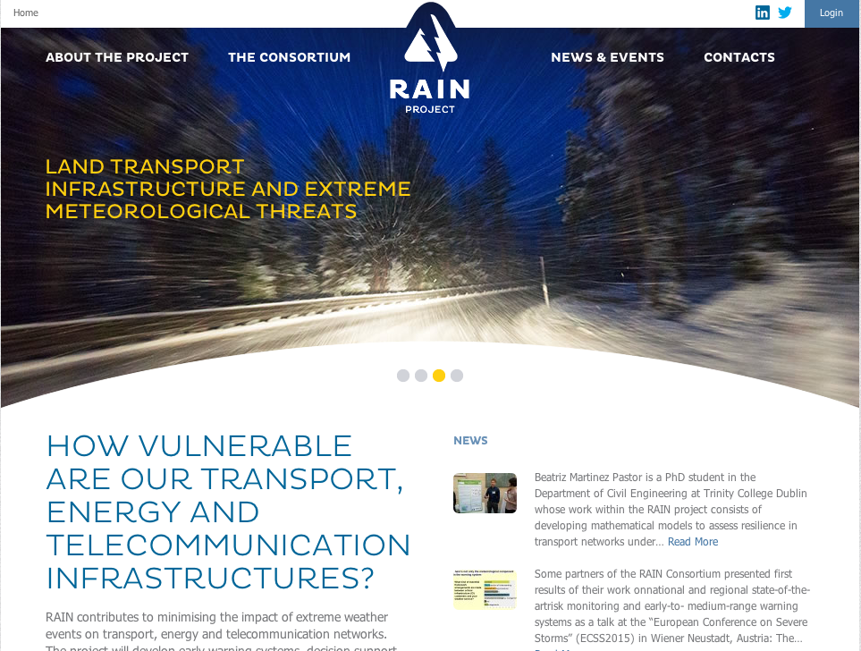
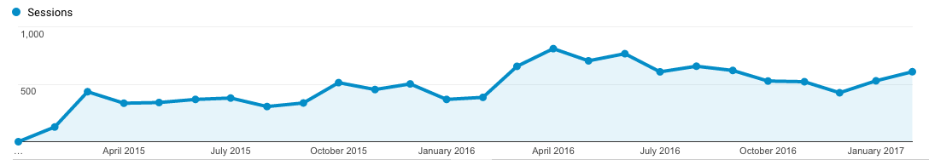
Dissemination & Exploitation

Slide 40
Dissemination & Exploitation
Types | Title | Data
Interview | Alan O’Connor – Taming nature’s wild character | 16.12.2014
Interview | Mitigating the impacts of extreme weather | 08.01.2015
Article | Learning from the past to prepare for future extreme weather events | 14.01.2015
Article | Preventing a Fukushima disaster in Europe | 27.04.2015
Article | Italy, Vajont “tsunami” and Malborghetto-Valbruna floods: such different lessons from the past | 21.07.2015
Article | The sun is shining… Let’s prepare for severe weather! | 15.12.2015
Article | Extreme weather: hi-tech predictions of impacts | 10.03.2016
Article | The cost of blackouts in Europe | 26.04.2016
PR+VNR | Climate change and extreme weather events: is Europe ready? | 31.05.16
Article | Bracing for summer thunderstorms | 13.06.16
Article | Facing weather disasters: Europeans must speak the same “language” | 18.07.16
Article | Cities: surviving floods and significant whims of the weather | 22.09.16
Article | Designing a new risk-based model to face extreme weather events | 07.11.16
Article | Supporting decisions in the case of extreme weather | 24.01.17

Slide 41


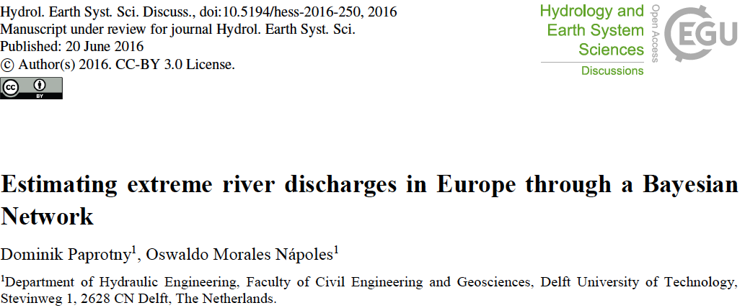

Dissemination & Exploitation
Publications: 15 Peer Reviewed Journal Papers (Published & In Press)
47 Papers Published at National & International Conferences

Slide 42
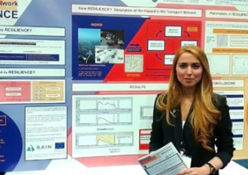





Dissemination & Exploitation

Slide 43
Conclusions
The Risk Analysis of Infrastructure Networks Project - RAIN has (a.o.):
  Developed an online repository of pan European gridded datasets of EWE probability of occurrence under present and future climate scenarios,
  quantified the complex interactions between extreme weather events and land based infrastructure systems (e.g. transport, telecoms, energy etc.),
  developed an operational analysis framework (i.e. Risk Based Decision Making Framework) that considers the impact of individual hazards and the coupled interdependencies of critical infrastructure through robust risk and uncertainty modelling, considering cascading effects and time dependent vulnerability,
  developed technical and logistic solutions to minimise the impact of these extreme weather events, through definition of early warning systems and the development of a web enabled risk based decision support tool.

Slide 44

RAIN Project www.rain-project.eu
Dr. Alan O’Connor alan.oconnor@tcd.ie

